Slide 1

Studio: Arts & Culture
Taylor Lallas, Krishnan Nair, Baker Sharp, Ayelet Drazen

Slide 2



Meet Our Team
Baker Sharp
B.S.. Computer Science
Taylor Lallas
B.A. Economics
M.S. Computer Science
Krishnan Nair
B.S. Computer Science
Ayelet Drazen
B.A. Political Science
M.S. Computer Science

Slide 3
PROBLEM:
People would like to get authentic personal perspectives on new cultures, especially when exploring new places . In addition, there sometimes exists a barrier in connecting directly with locals, but the desire to connect exists.
To enable cultural immersion, we provide a platform for people to share and listen to personal stories and experiences that are connected to specific locations.
Notes:
I think the problem and solution overview could just a touch bit more refining; I don't think it's precise to simply pin the problem on the questions. I would lean in a little bit more on the "personal perspectives" part and add something about specifically allowing people to get a feel for a place.
Value prop and mission statement are good - I might change "stories from locals" to "local narratives" because it rolls off the tongue better.

Slide 4
MISSION STATEMENT
Enabling cultural immersion through local narratives
VALUE PROP
Illuminate your world

Slide 5
OVERVIEW
01
02
03
TASKS
REVISED INTERFACE DESIGN
PROTOTYPE OVERVIEW

Slide 6
01
TASKS

Slide 7
Tasks
SIMPLE - Find and Listen to a Story
MODERATE - Add to a playlist
COMPLEX - Share a story
Notes:
Insert image of prototype pages relevant to listening to a story
Focus on simplicity
Primarily pushing buttons/minimal text input
Phone interface

Slide 8
02
REVISED INTERFACE DESIGN

Slide 9
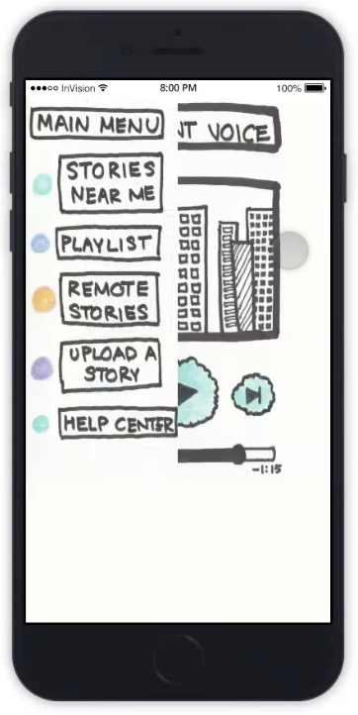
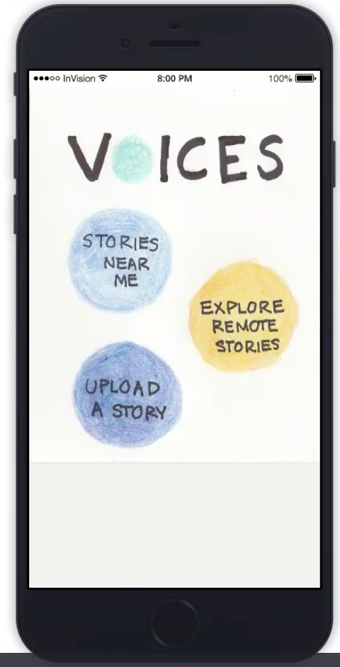
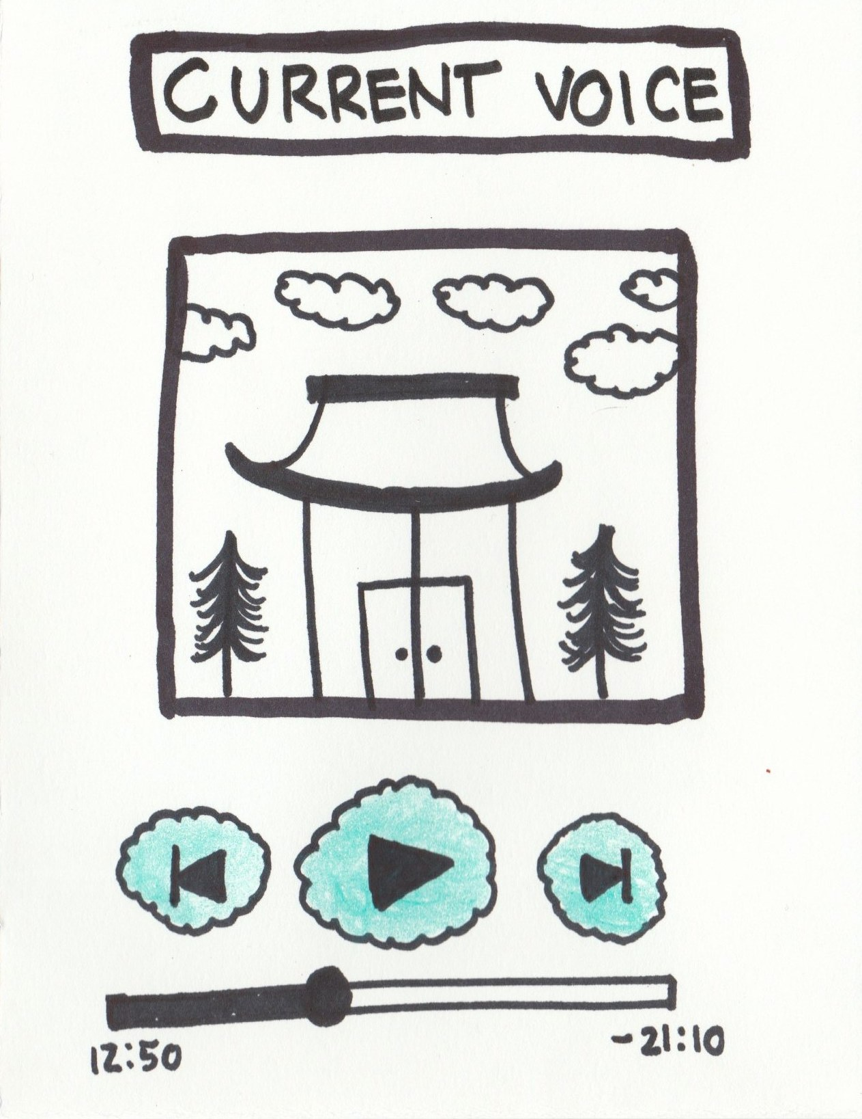
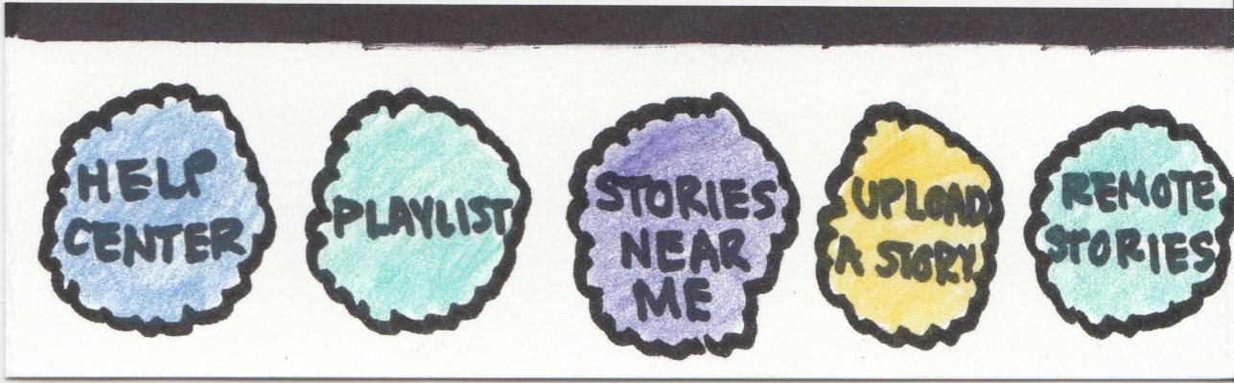
UI Revision #1: Navigation
Before
After

Slide 10
UI REVISION 1: Navigation

Slide 11
UI REVISION 1: Navigation
Before:
We originally had a side swipe menu that allowed participants to navigate between different parts of the app (finding remote/nearby stories, uploading stories, playlists). However, interviewees felt that the menu was unintuitive and difficult to access. Many were looking for the three lines icon (i.e. the hamburger menu) to for navigation. People were frustrated that they couldn’t easily switch between playlists and finding stories.
After:
We designed a persistent navigation bar that is situated at the bottom of the screen. We believe a clearly visible and easily accessible bar will make navigation easier. We want navigation to be a subconscious process, so that that navigation does not detract from the experience of the app. For our medium-fi prototype, the design of our navigation bar changed to be more simplistic. We use icons to eliminate unnecessary text and combine the “stories nearby” and “remote stories” functionality” as they require the same interface–a map.

Slide 12
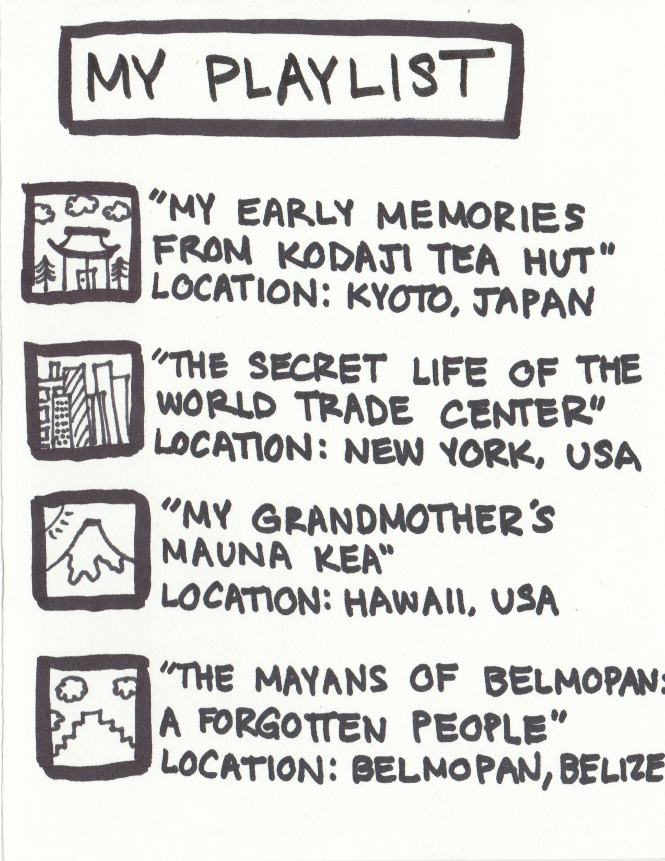
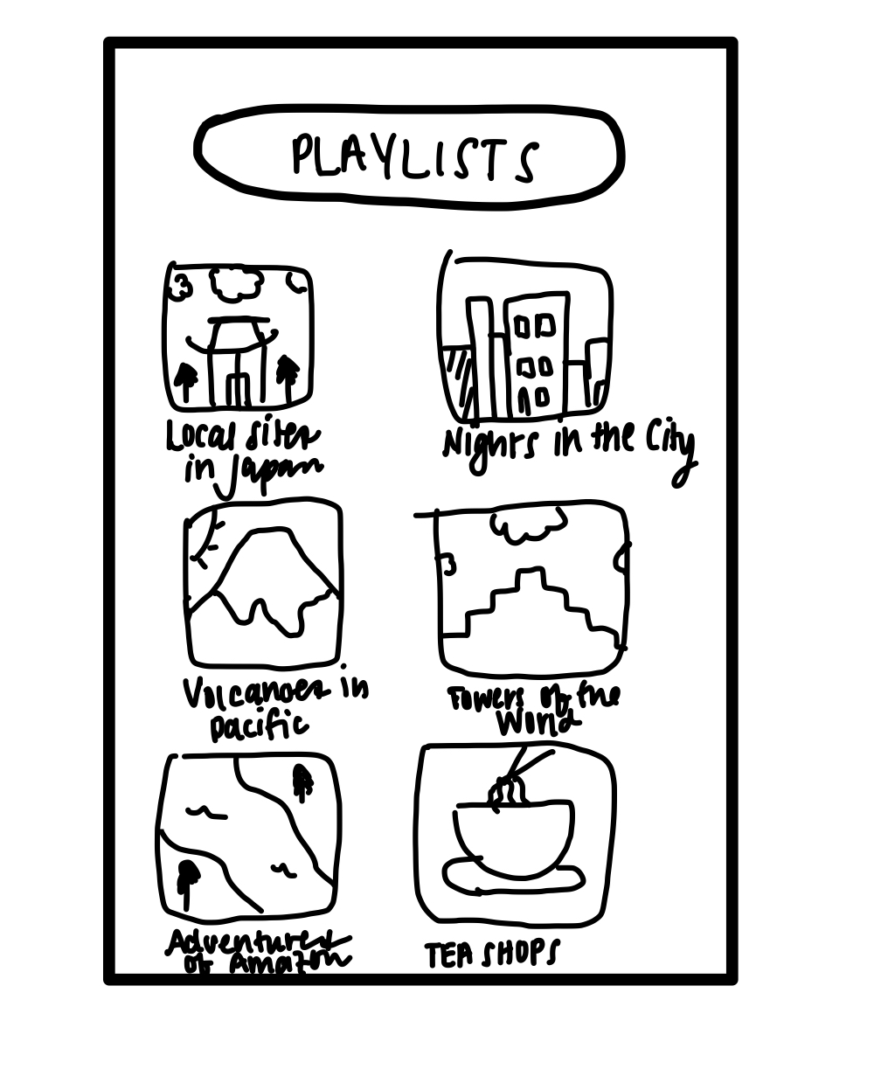
UI REVISION 2: Playlist
Before
After

Slide 13
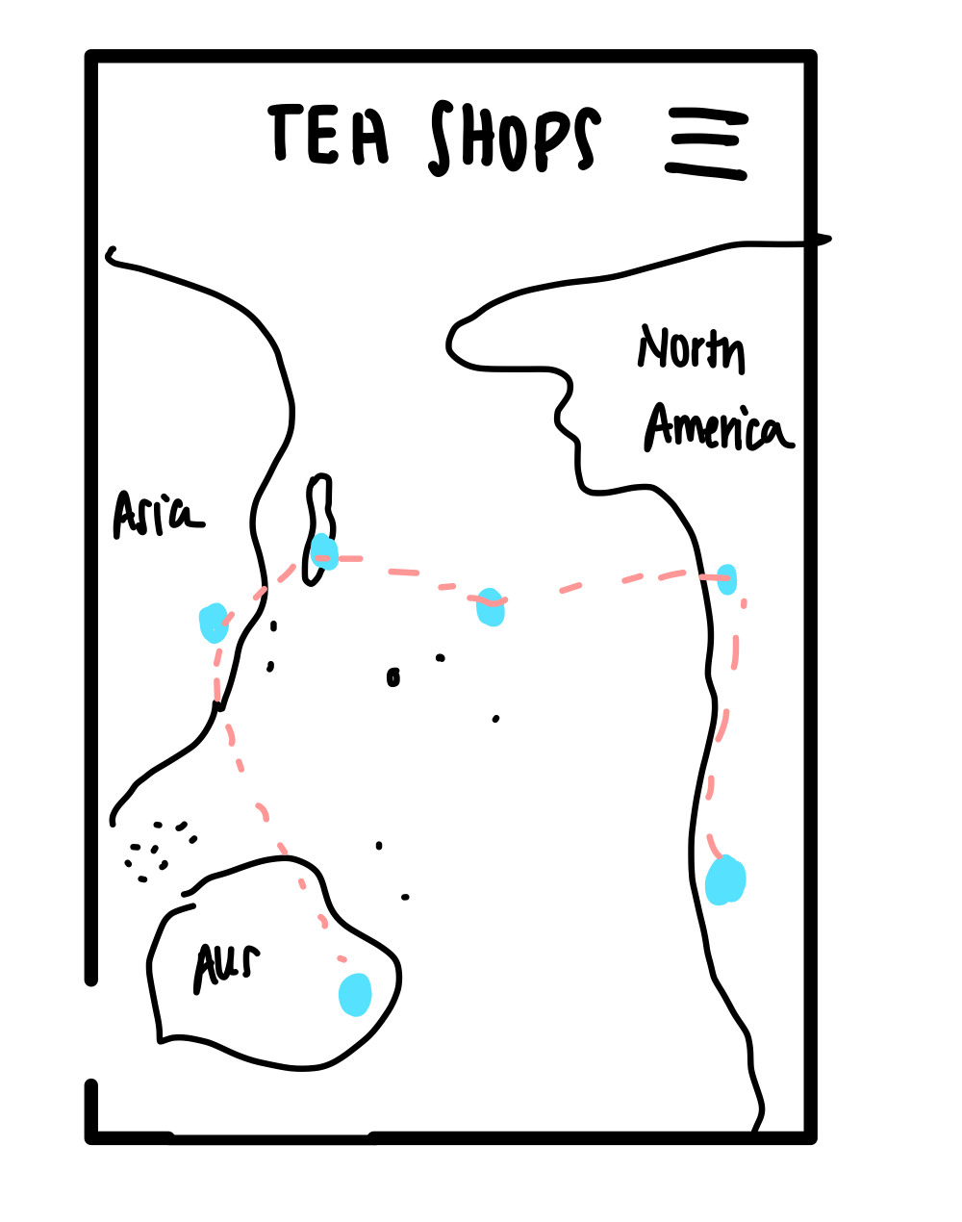
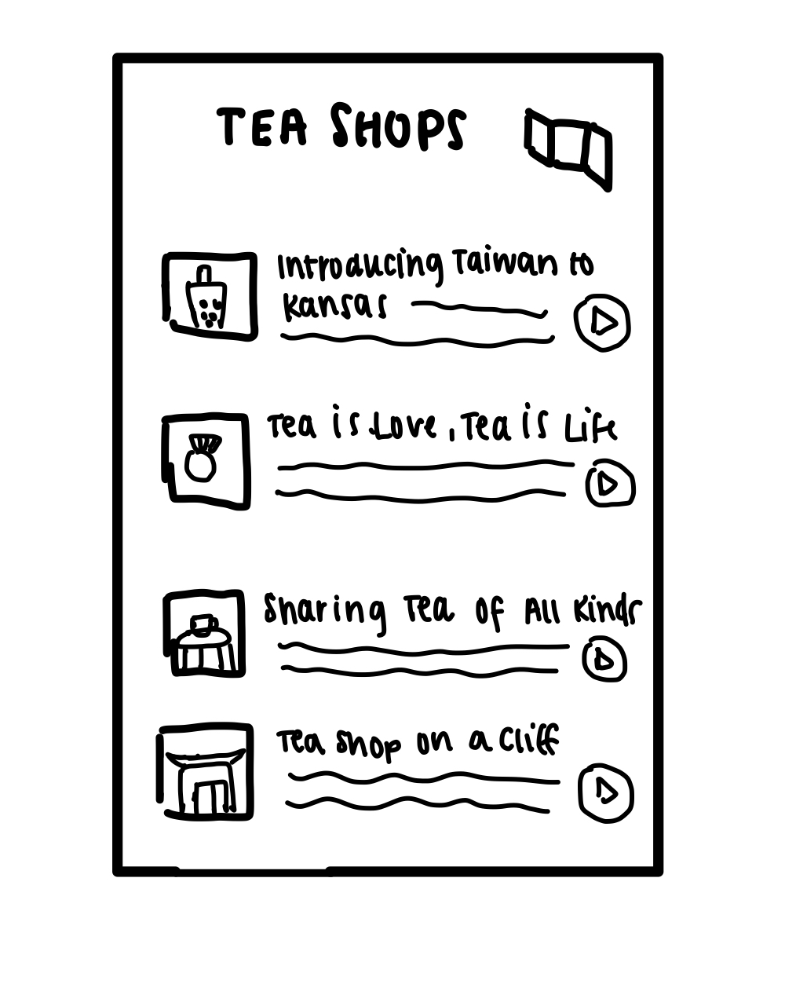
UI REVISION 2: Playlist
Map View
List View

Slide 14
UI REVISION 2: Playlist
Before:
We originally had a playlist functionality that served almost like a saved library. Users could save stories they want to listen to later for easy access. During our interviews, we learned that people wanted more options to sort and categorize their stories in playlists. This brought up the need to create individual playlists that users can design based on common themes or locations. We also learned that users wanted to see their saved stories back on the map in order to draw visual connections, and orient themselves.
After:
We revamped our playlist by allowing users to create as many playlists as they want. We then provide two viewing options for the playlists. The users can either view the playlists via a list view, similar to the interface used when searching for stories or they can switch to a map view using the icon on the top right. This allows them to see how their stories are connected to one another geographically, enabling user to make cross- cultural connections via narratives.

Slide 15
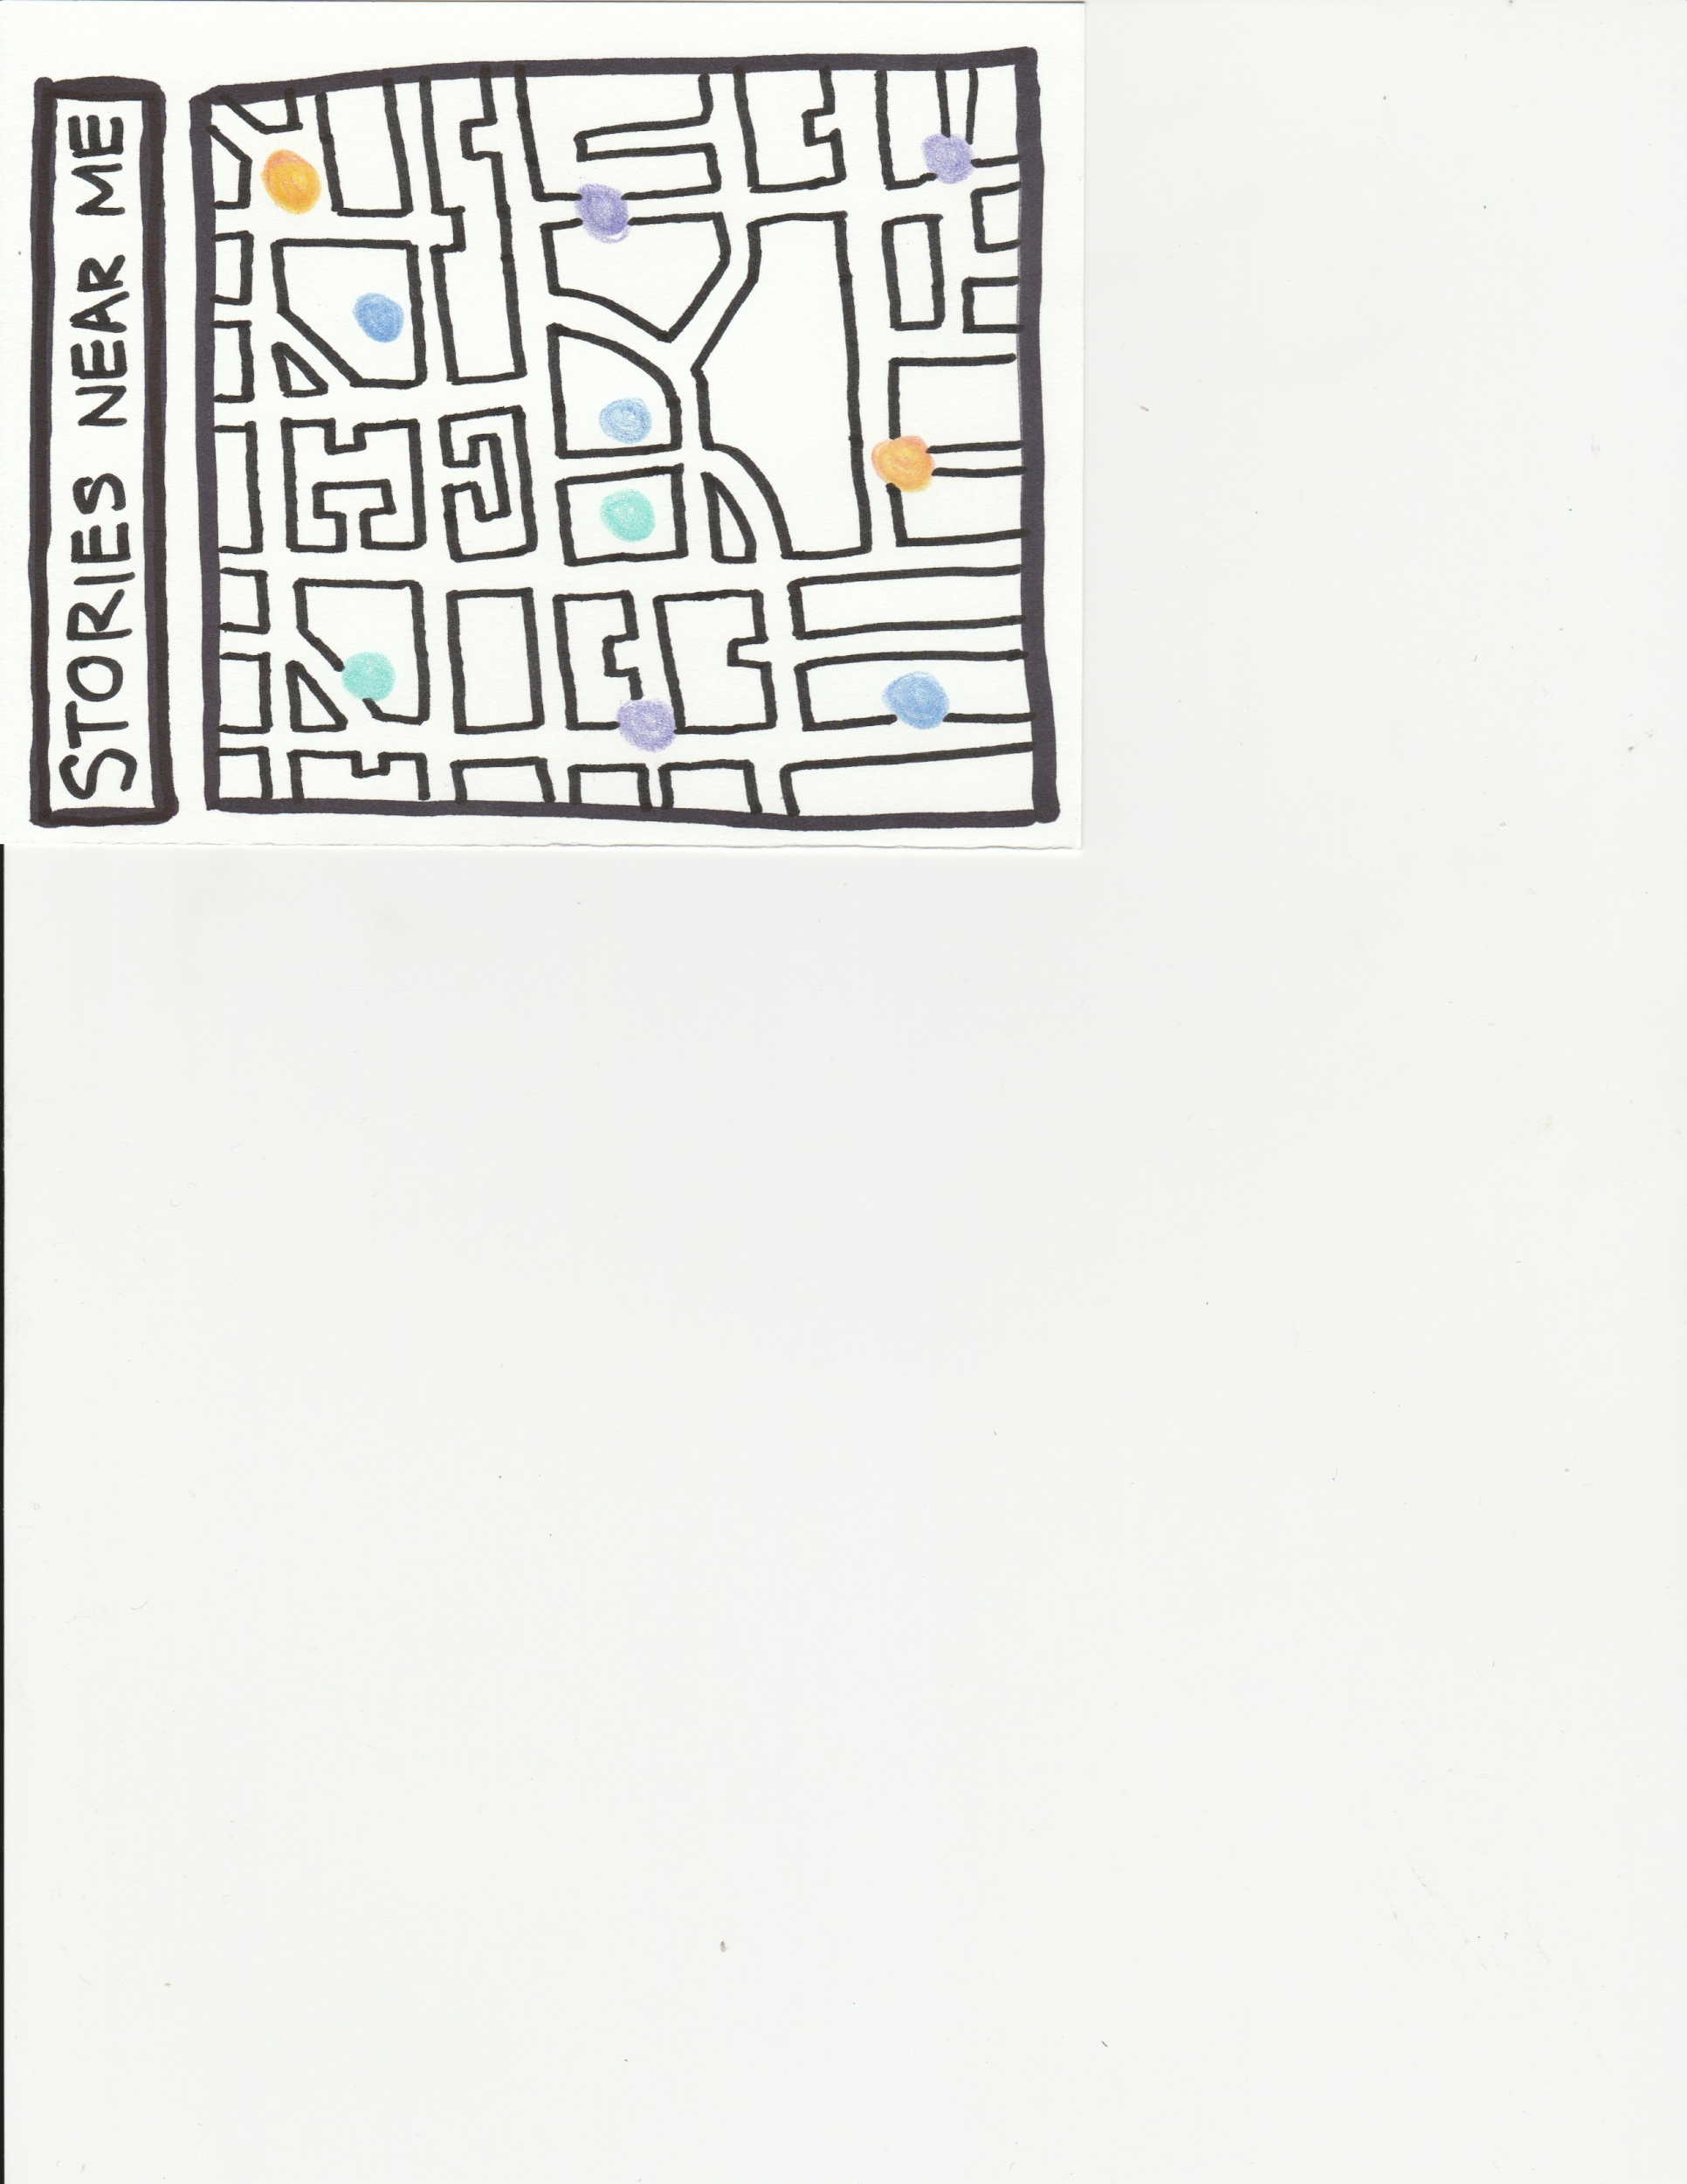
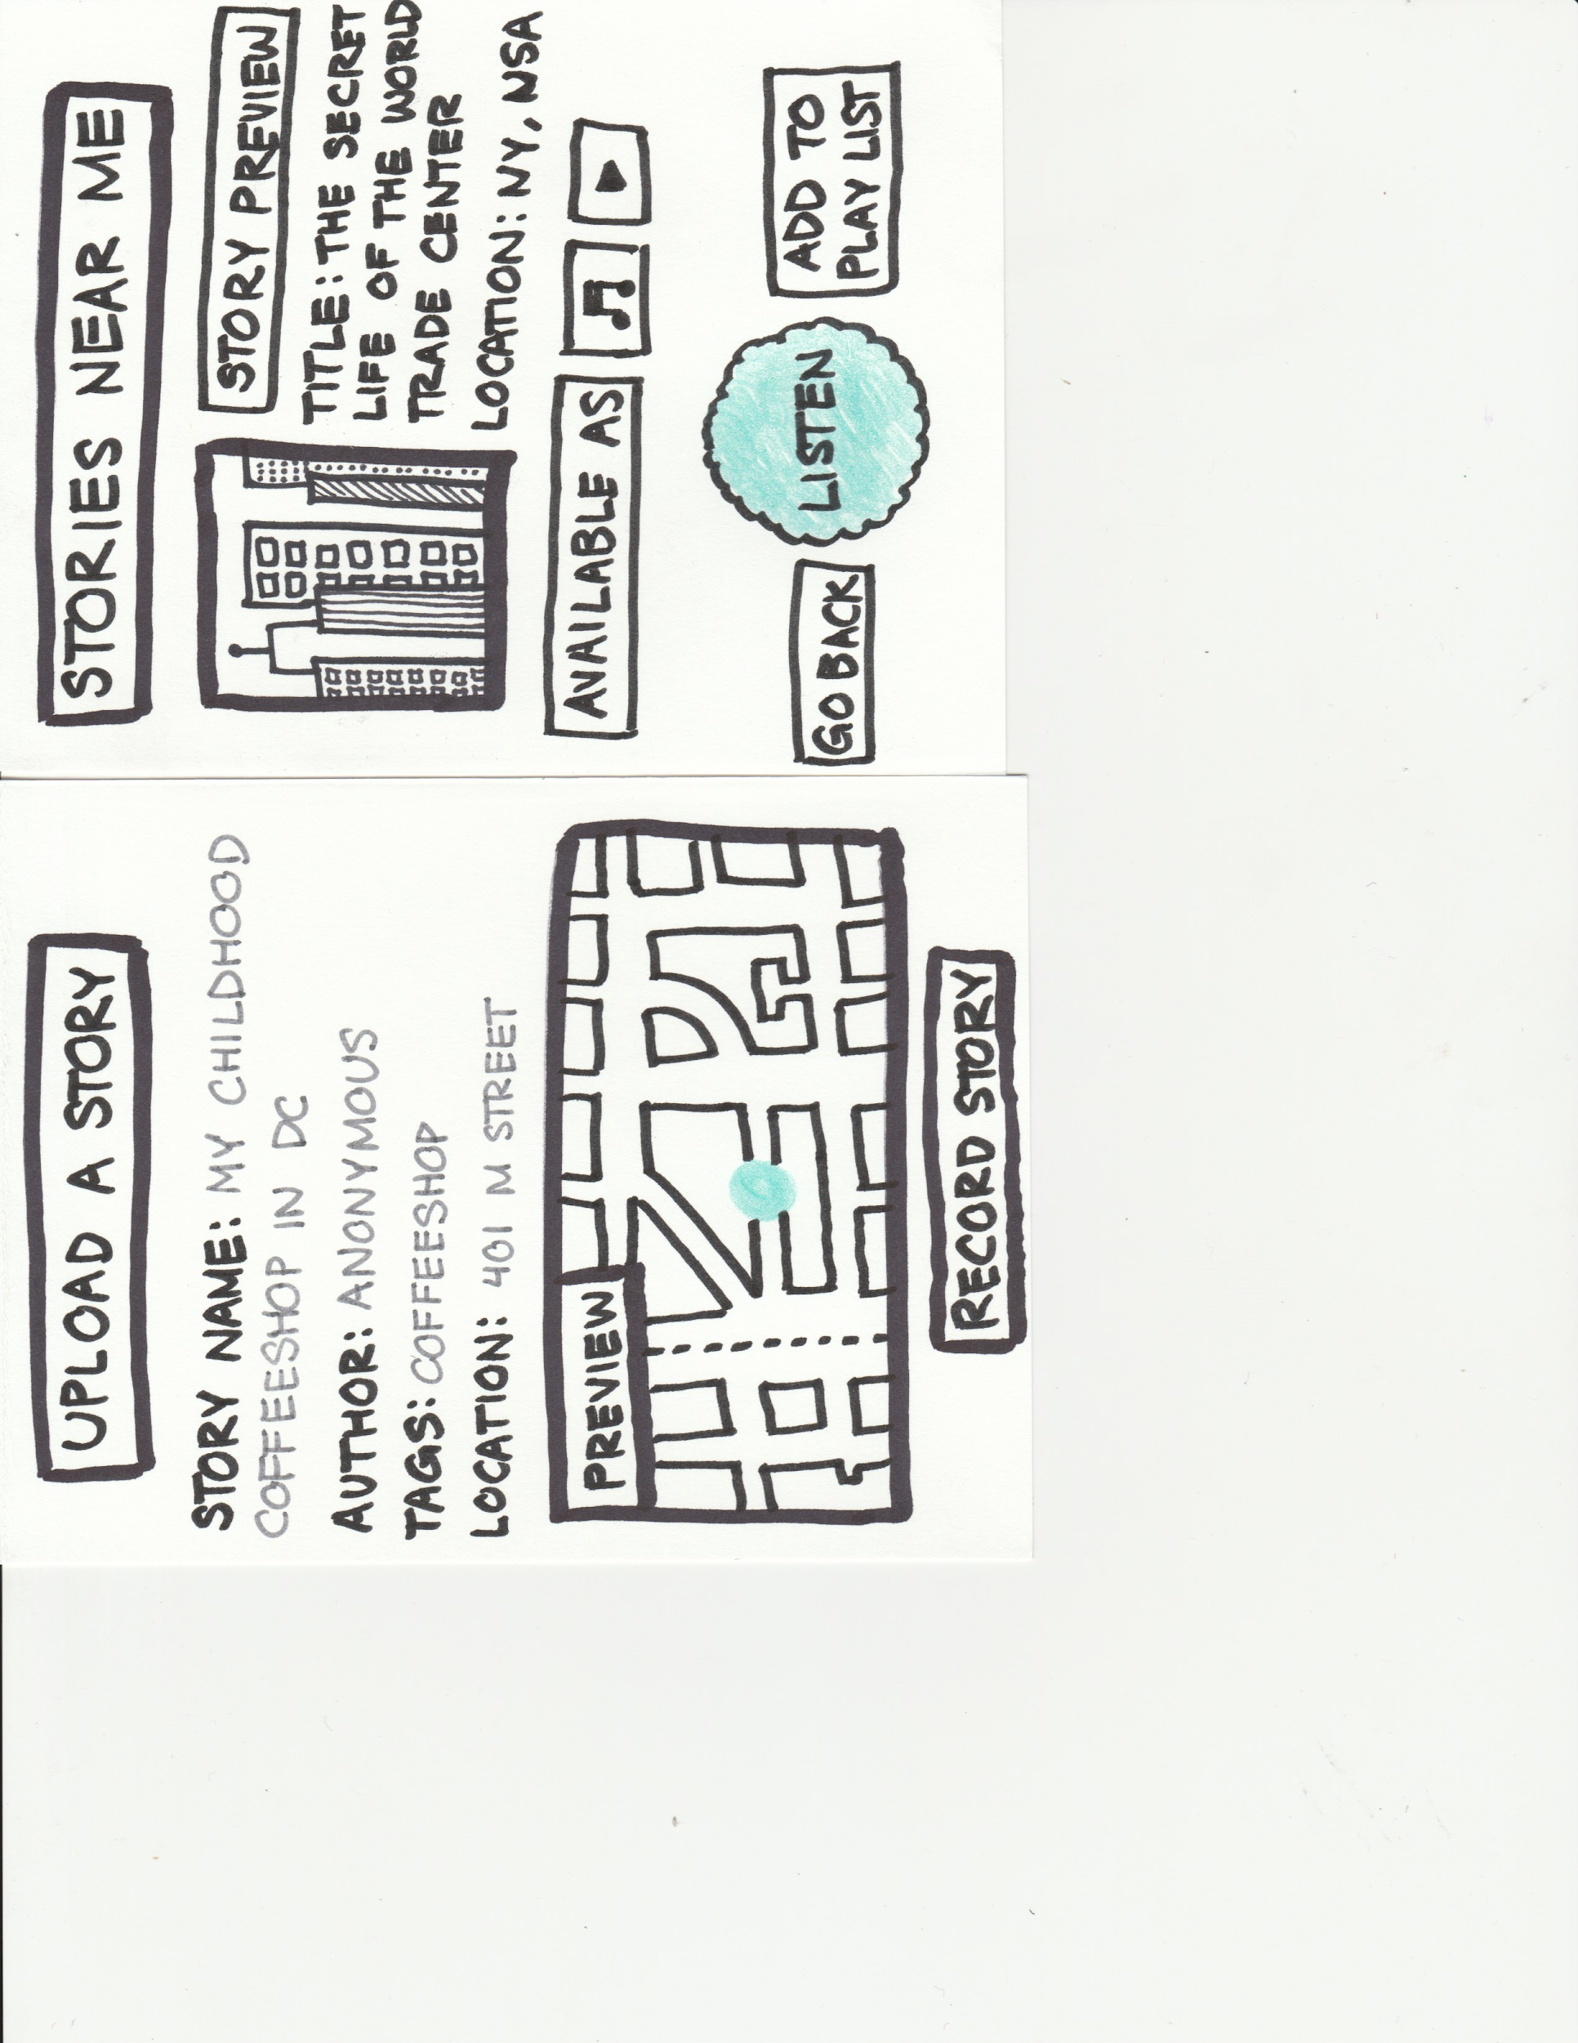
UI REVISION 3: Switching between Stories
Before

Slide 16
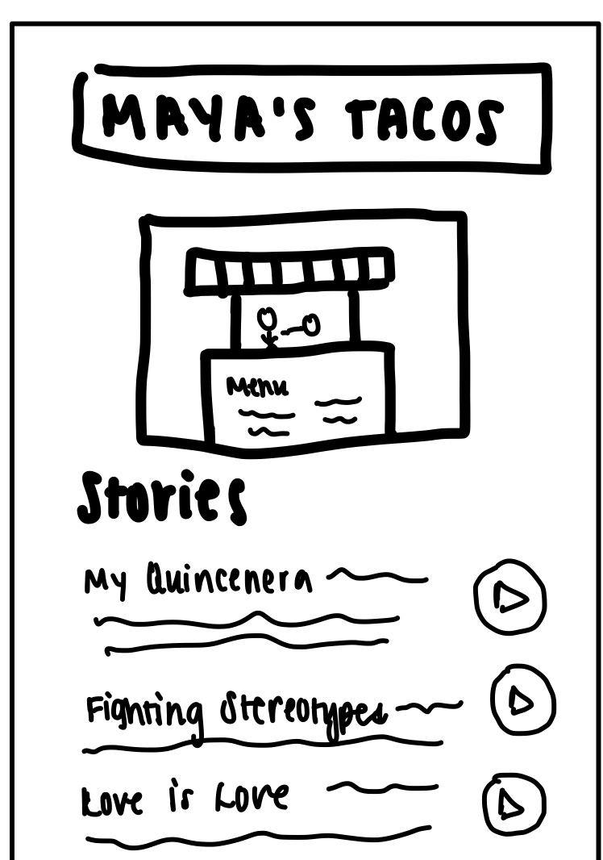
UI REVISION 3: Switching between Stories
After

Slide 17
UI REVISION 3: Switching between Stories
Before:
Originally, the map had multi-colored glowing orbs that indicated individual stories. When you click on the glowing orb, it takes you directly to the story preview. Based on our prototype testing, we realized that most people associated the orbs with key locations rather than stories themselves. Many people were confused because the prototype made it seem as if there is a maximum of one story per location at any given time. However, our mission is to provide users with multiple local perspectives, not just a single one.
After:
We plan to redesign the flow of finding and listening to stories to provide easier access to different stories at the same location. To do this, the glowing orbs appear at key locations with an image of that location. When you click on an orb, it opens a page that contains a list of stories that are at that location. A user can then choose to play the story directly on that screen, or click the page for more information and a more detailed story listening screen.
Notes:
Simple task was originally just listen to a story. However, this went hand in hand with finding a story and we assumed that most people would listen to the story even if we just instructed them to find it. Thus we combined them as our simple task as it is the most intuitive out of all three and most streamlined in our opinion.

Slide 18
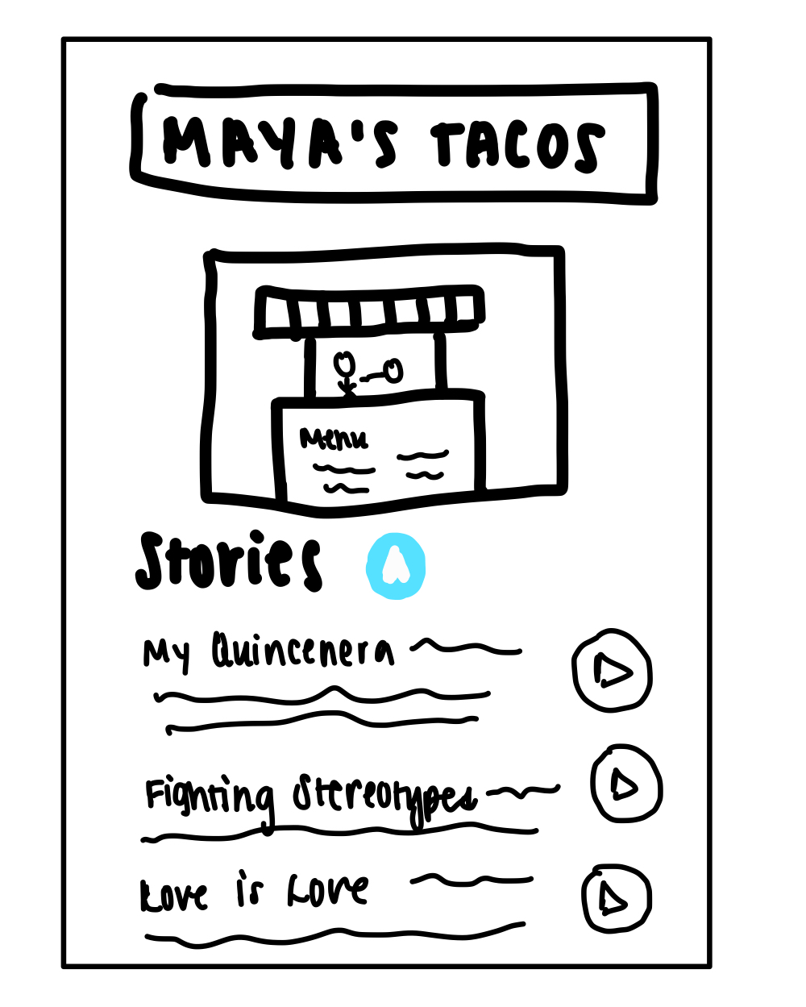
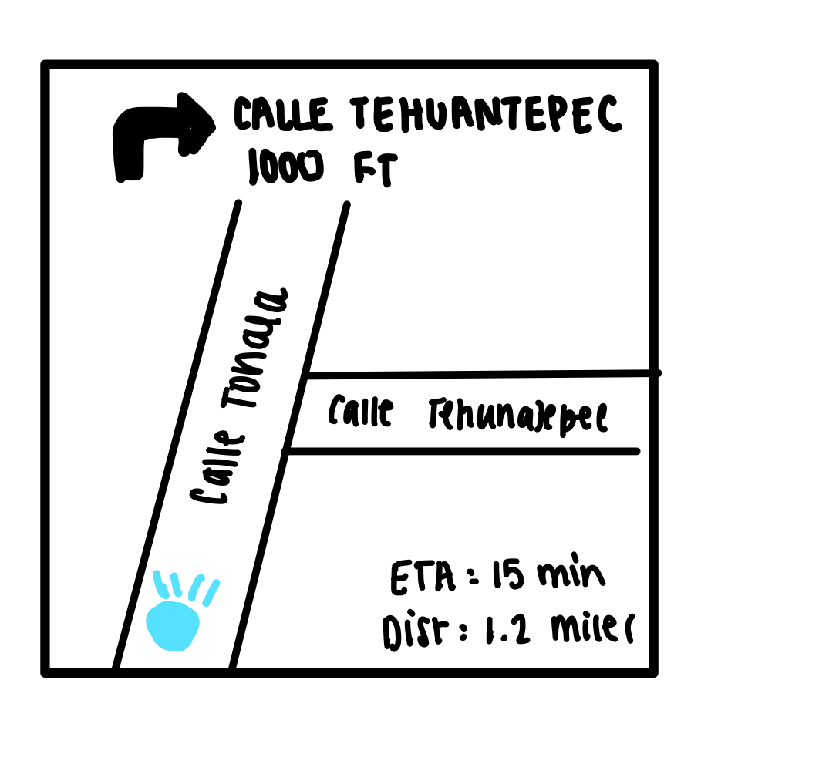
UI REVISION 4: Direction to Stories
Before
After

Slide 19
UI REVISION 4: Direction to Stories
Before:
We originally did not have any functionality that allowed users to gain access to directions/navigation to the location of the stories. During our interviews, we learned that people envisioned themselves using the app to plan their days and would like to visit the sites associated with the stories they are listening to. This came as a surprise as we thought people would prefer to just stay at home to listen to stories during their free time. However a sense of adventure was desired when exploring new cultures.
After:
On the stories preview page, we now include a blue navigation button if the story is within a reasonable distance of the user (100 miles). The cap on distance is implemented because we do not want to include navigation/directions for stories in other countries or those that are incredibly far away. The navigation will be in app to provide a streamlined service as opposed to requiring users to jump between apps when trying to navigate to a story. This will be especially useful for users who are physically exploring a new place they are familiar with.
Notes:
Simple task was originally just listen to a story. However, this went hand in hand with finding a story and we assumed that most people would listen to the story even if we just instructed them to find it. Thus we combined them as our simple task as it is the most intuitive out of all three and most streamlined in our opinion.

Slide 20
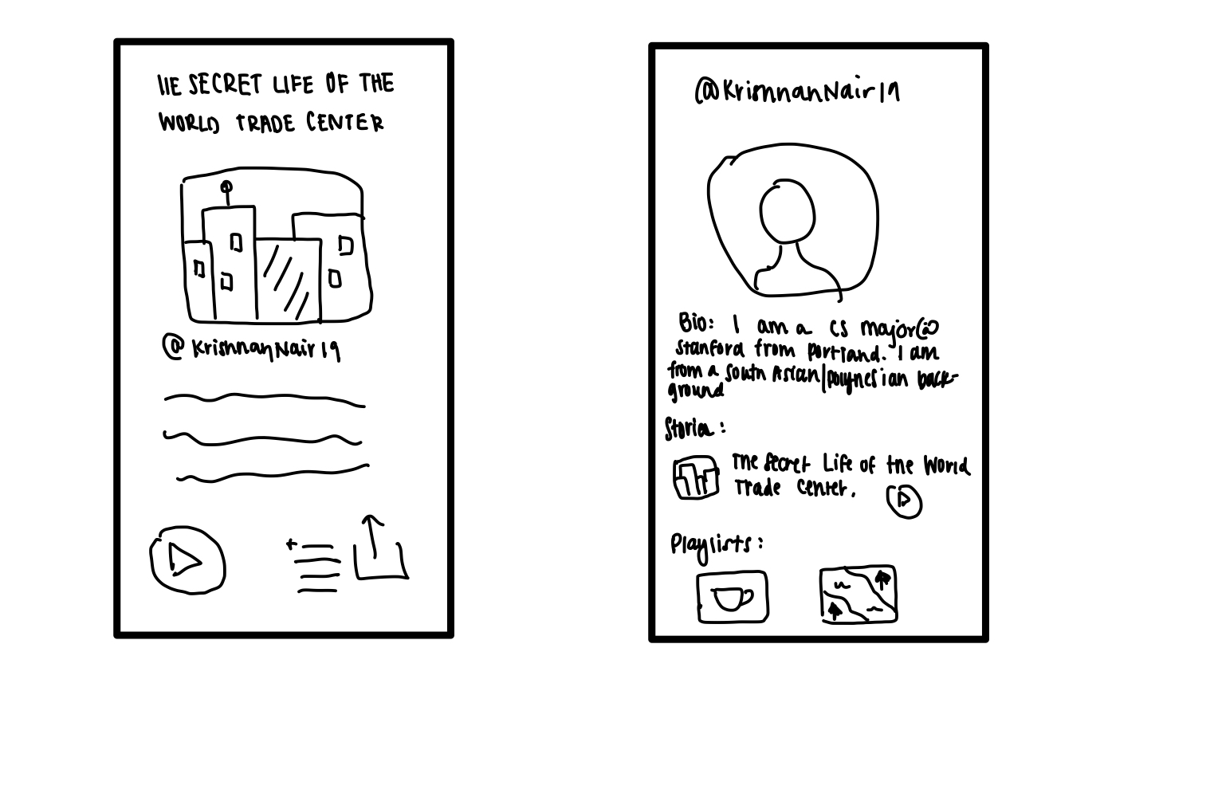
UI REVISION 5: Profiles
Before
After

Slide 21
UI REVISION 5: Profiles
Before:
During our prototyping interviews, we quickly learned that there was a desire to connect with the authors of stories on a deeper level. Users also wanted to ensure that the stories they listen o were coming from locals and not tourists or random bots. This user need came into conflict with wanting to relieve the pressure that locals feel when being bombarded with questions. To balance this tension, we turn to other forms of information that can be provided for users to learn more about authors, such as a biography, access to an author’s other stories, and an author’s playlists. We also need a way of providing some sort of credibility to the authors of the stories.
After:
To address these issues, we develop an author profile each author that is displayed on stories. The profiles give users greater insight in to the author’s background and perspectives while maintaining some distance for comfort on both ends. The information available includes a biography, a list of the author’s stories, and the author’s playlists. In this profile section, authors can specify their relation to the locations they tell stories at and how their perspective is unique.
Notes:
Simple task was originally just listen to a story. However, this went hand in hand with finding a story and we assumed that most people would listen to the story even if we just instructed them to find it. Thus we combined them as our simple task as it is the most intuitive out of all three and most streamlined in our opinion.

Slide 22
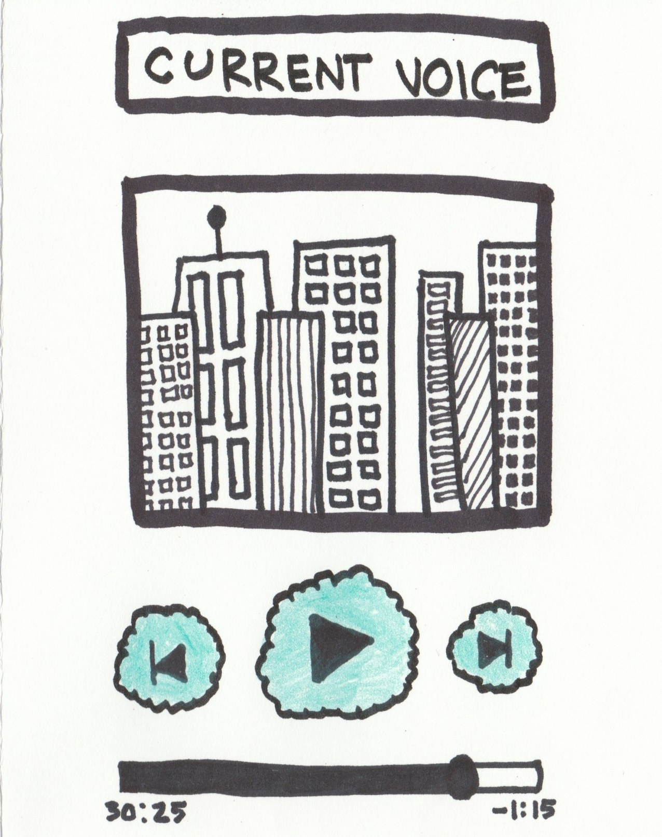
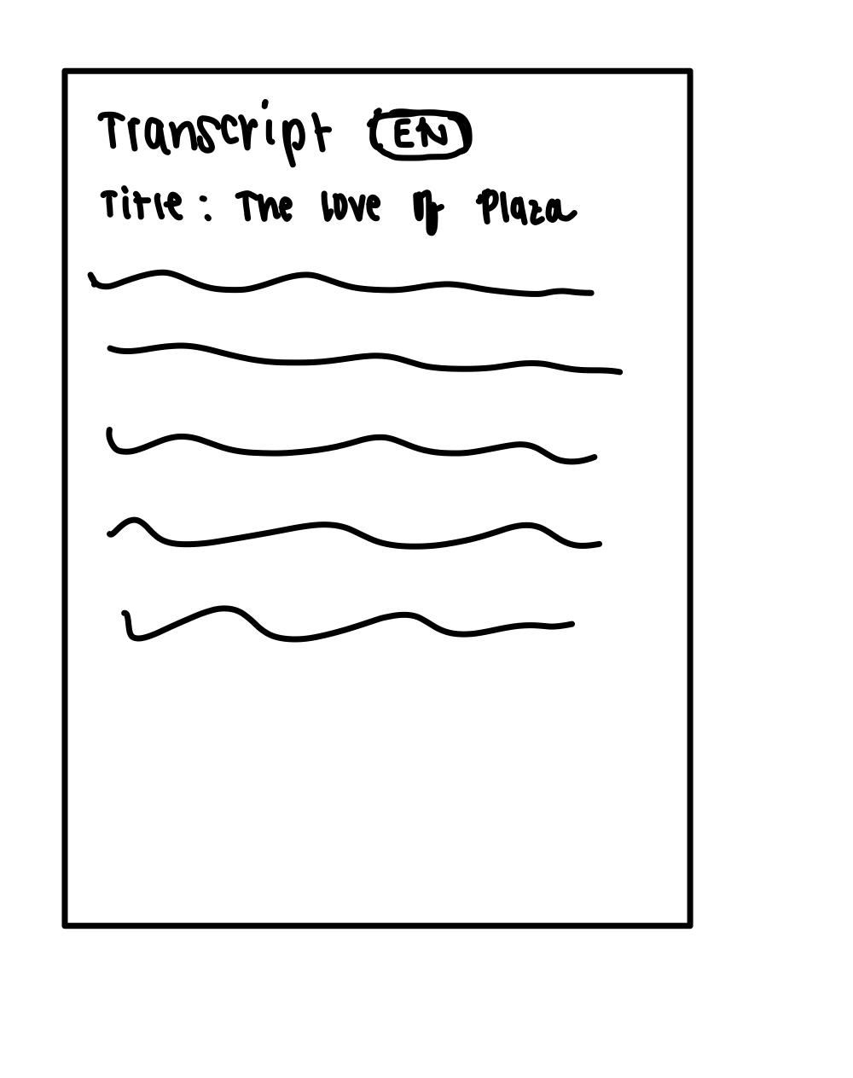
UI REVISION 6: Transcribing Stories
Before
After
Scroll down on page for transcript

Slide 23
UI REVISION 6: Transcribing Stories
Before:
During our interviews, several people were confused about the format of the stories. The current designed made it seem like the stories would be auditory. We would like auditory stories to be the default. However, several participants articulated a desire for transcribed stories that can be read. This would address accessibility barriers for those who are hard of hearing. Similarly, interviewees were confused as to how people will understand stories published in other languages. This is an especially important issue considering we want stories to be told by locals who do not necessarily speak English or the language of the listener.
After:
We add a transcription of the story beneath the story listening page. Ideally, this transcription would track with the story. We also include a button that allows users to change the language of the transcription, ensuring that this is an app that can be used by people of all backgrounds. The language preference will be set during the onboarding process.
Notes:
Simple task was originally just listen to a story. However, this went hand in hand with finding a story and we assumed that most people would listen to the story even if we just instructed them to find it. Thus we combined them as our simple task as it is the most intuitive out of all three and most streamlined in our opinion.

Slide 24
03
PROTOTYPE OVERVIEW

Slide 25
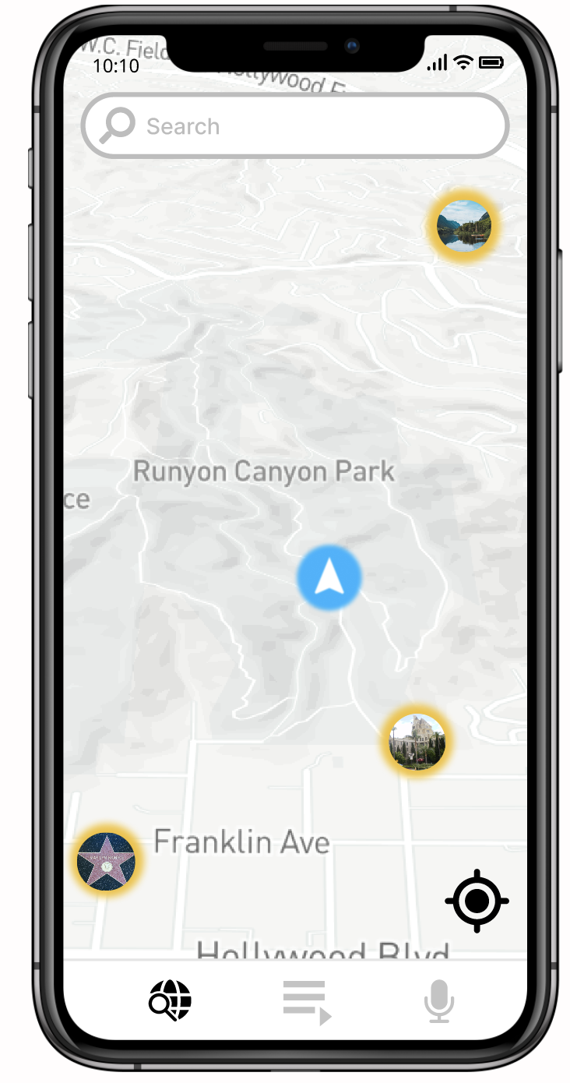
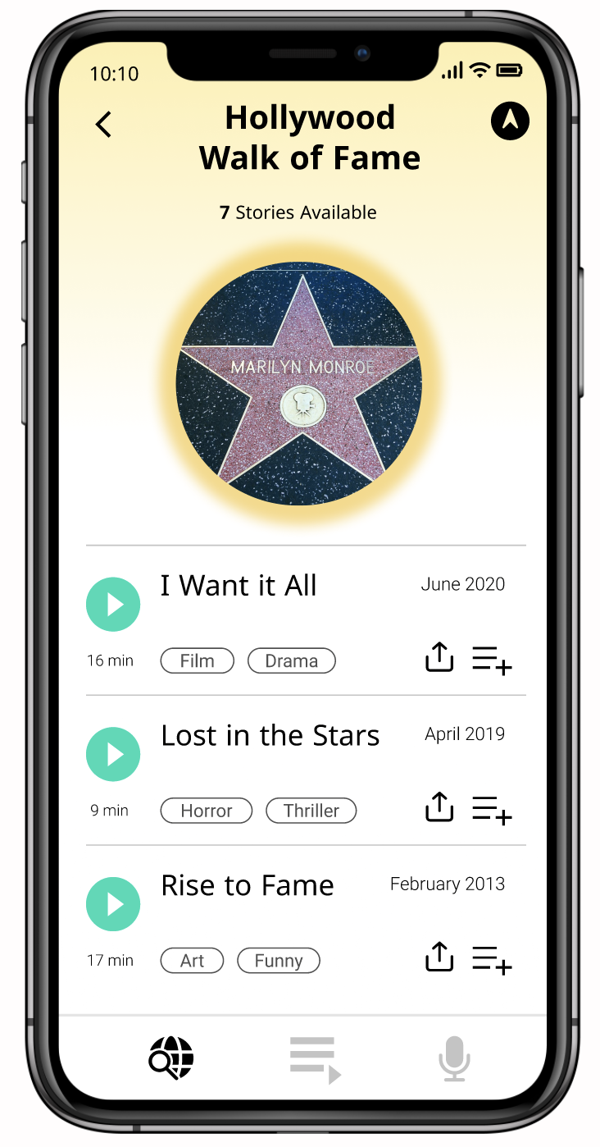
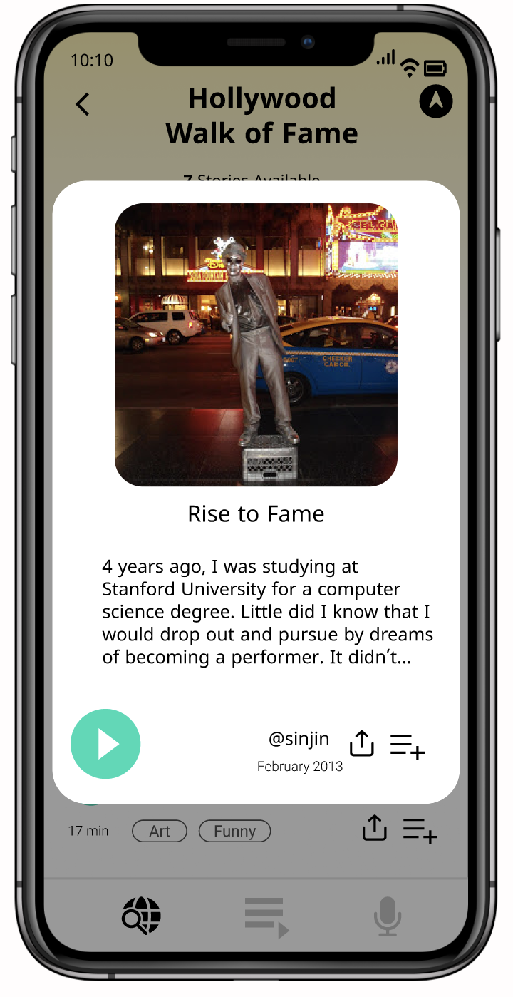
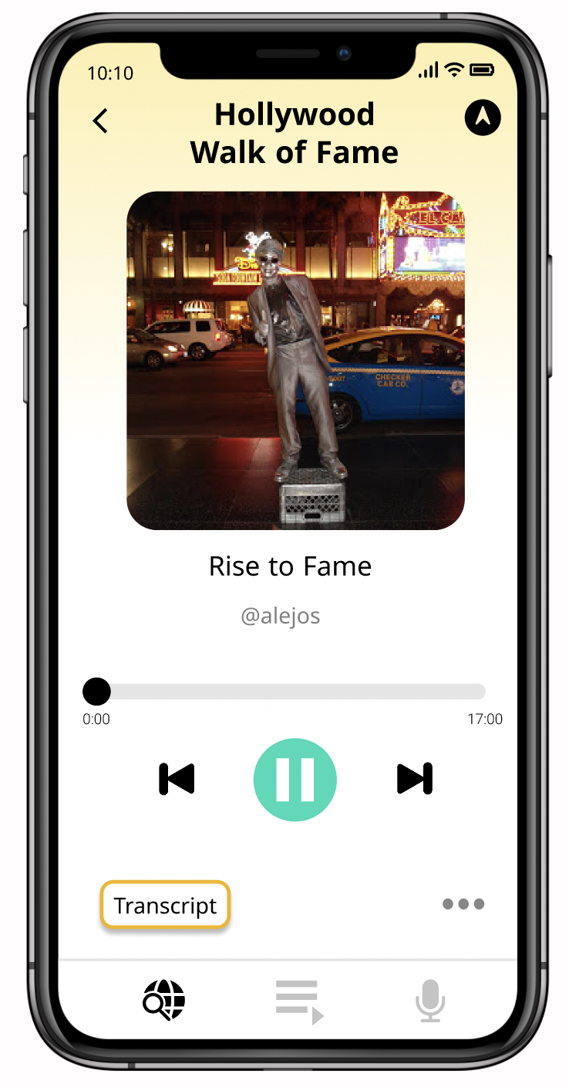
TASK FLOW: Find and Listen to A Story
Notes:
Method 1: Listening to stories nearby. The app will automatically open the map to stories near you (using your current location as a default). You can then click on the title to receive a preview of the story (first few lines of the transcript). Pressing the big mint play button allows you to play the story.

Slide 26
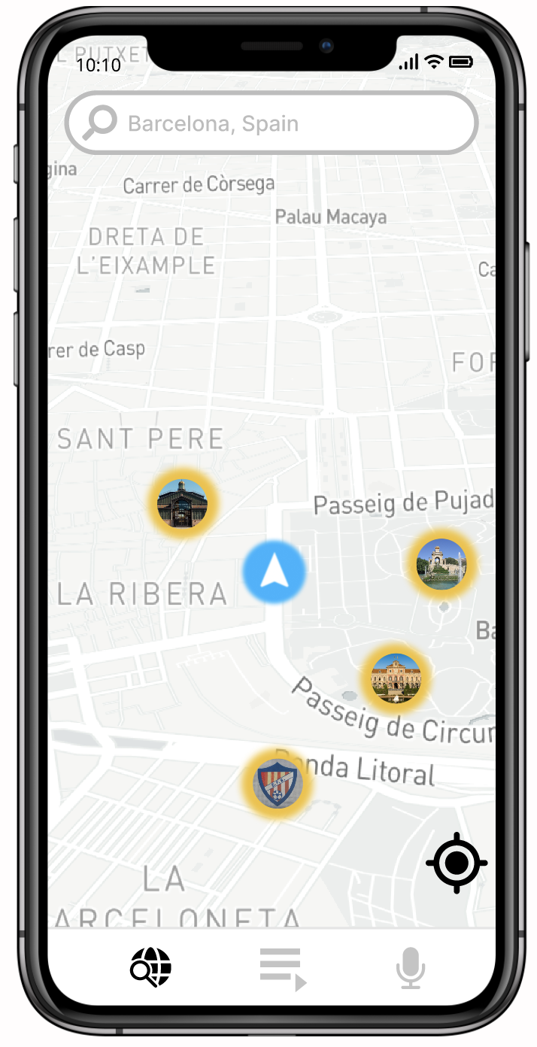
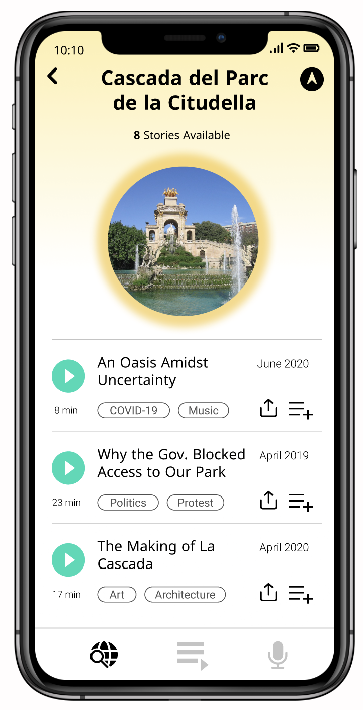
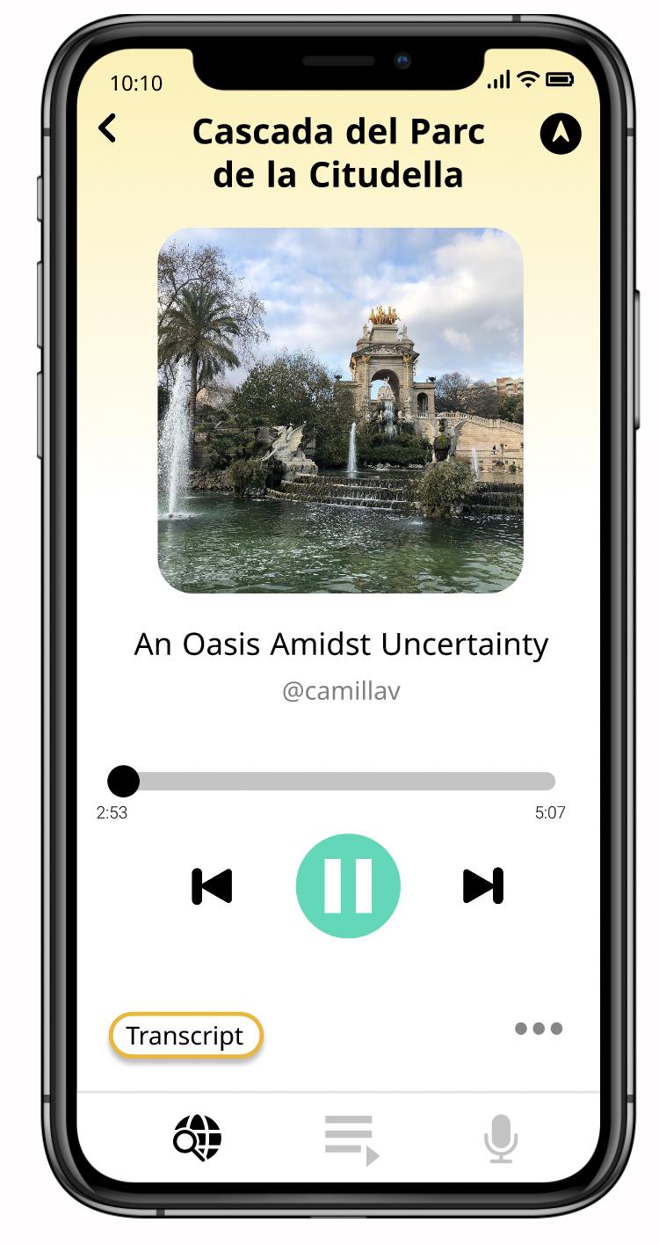
TASK FLOW: Find and Listen to A Story
Notes:
Method 2: Listening to remote stories. You can search for locations using the search bar. Then you can either listen to the story by pressing the mint button or using the preview page as pictured on slide 23.

Slide 27
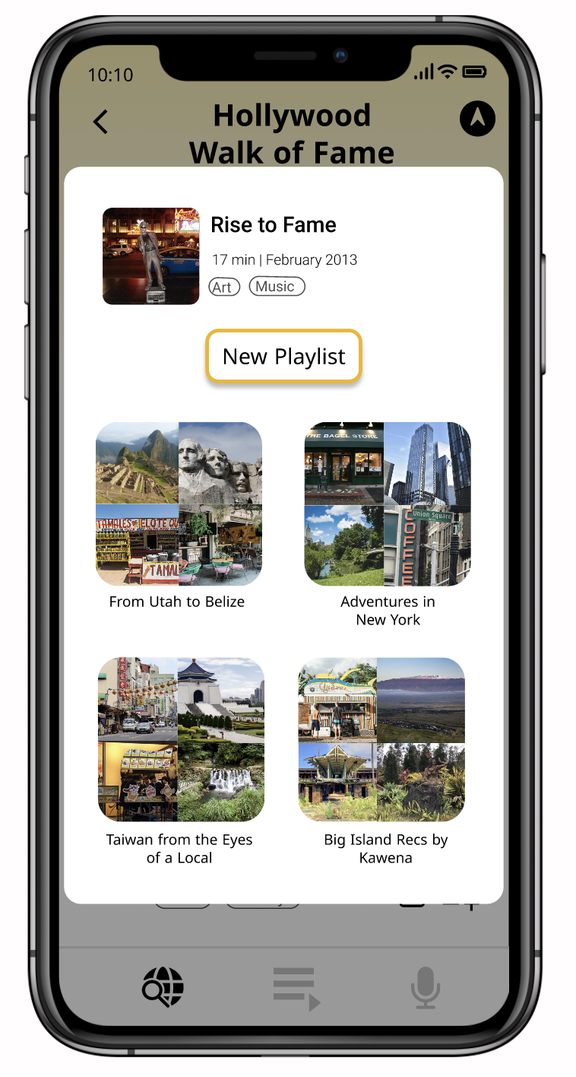
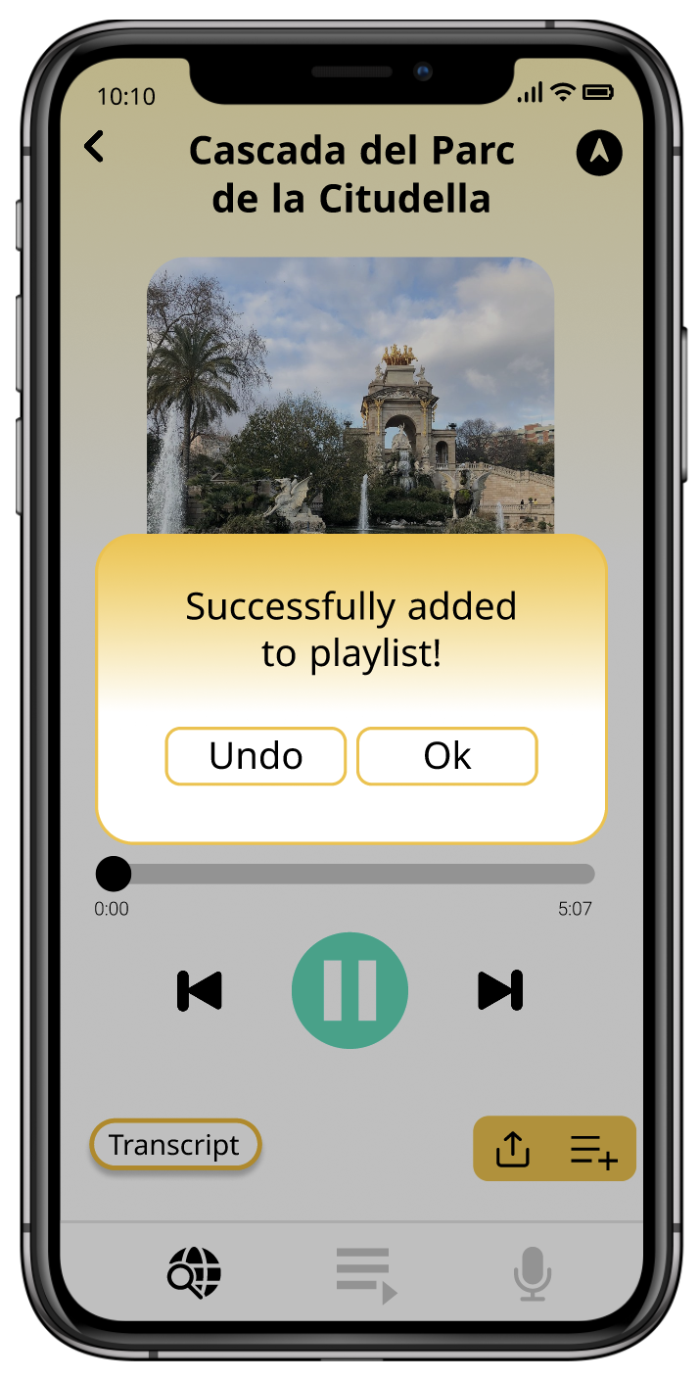
TASK FLOW: Add a Story to Your Playlist
Notes:
Method 2: Listening to remote stories. You can search for locations using the search bar. Then you can either listen to the story by pressing the mint button or using the preview page as pictured on slide 23.

Slide 28
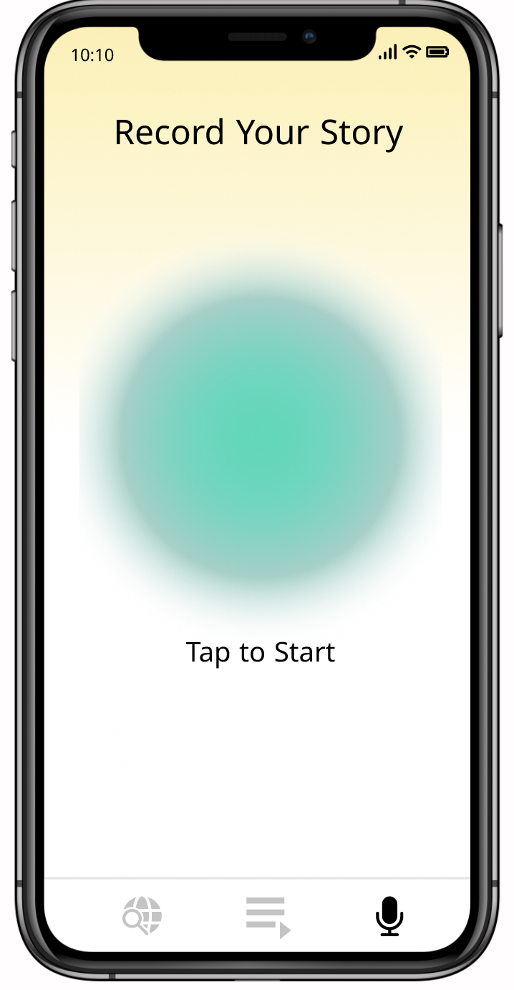
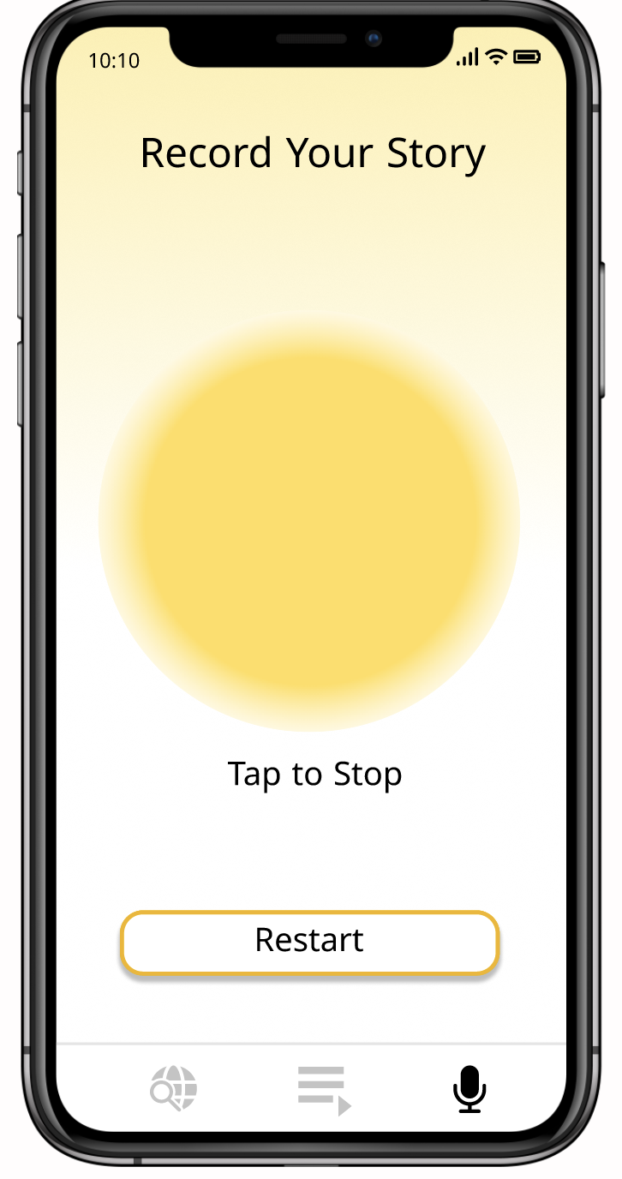
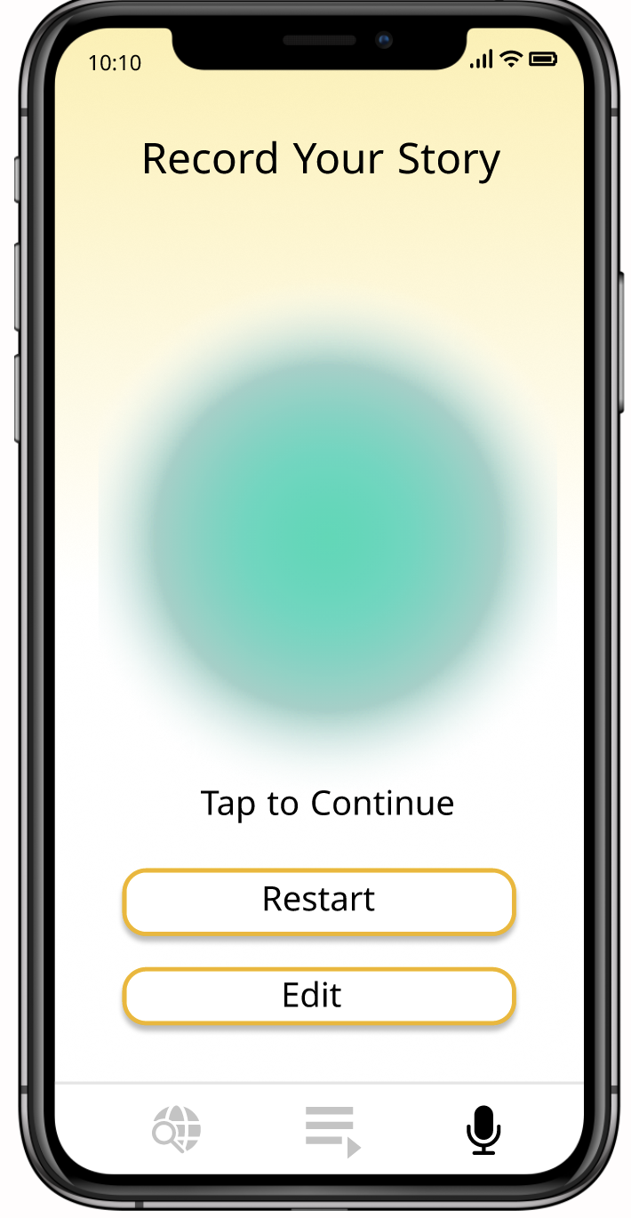
TASK FLOW: Record Your Own Story
Notes:
Method 2: Listening to remote stories. You can search for locations using the search bar. Then you can either listen to the story by pressing the mint button or using the preview page as pictured on slide 23.

Slide 29
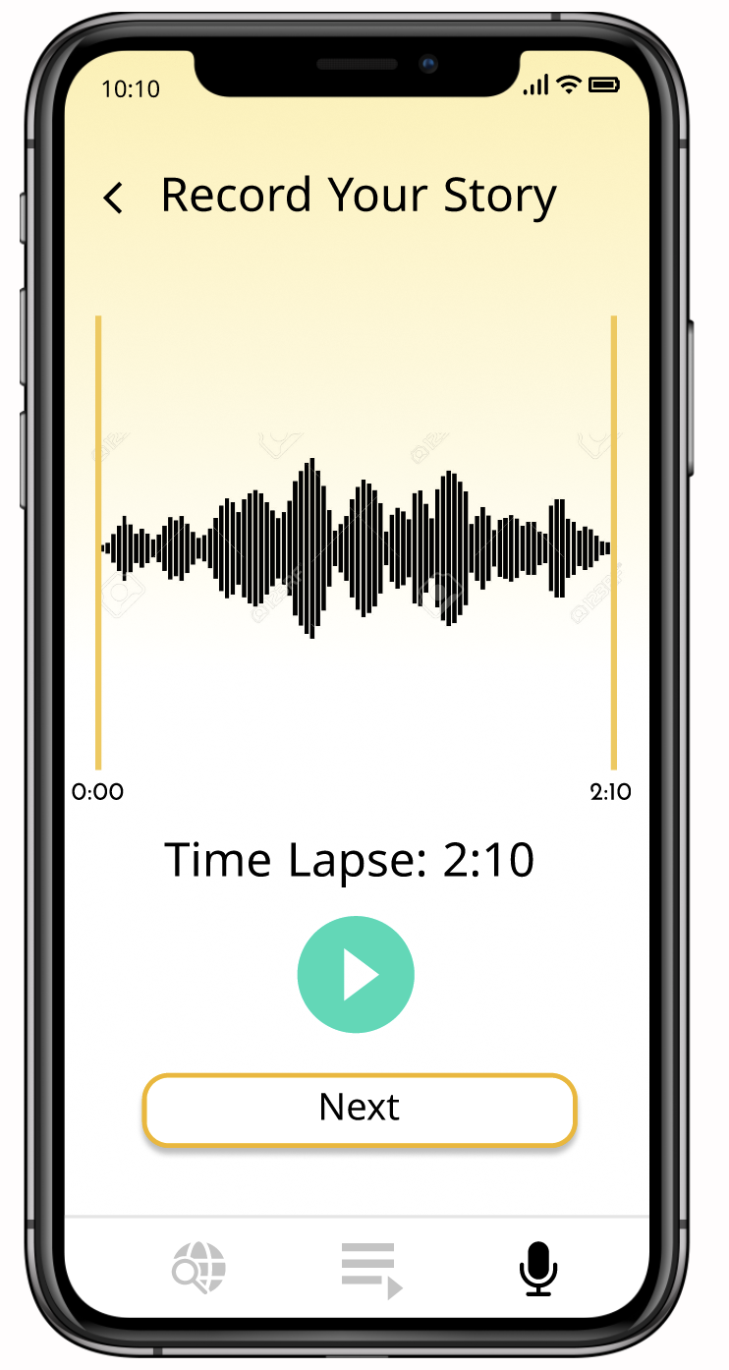
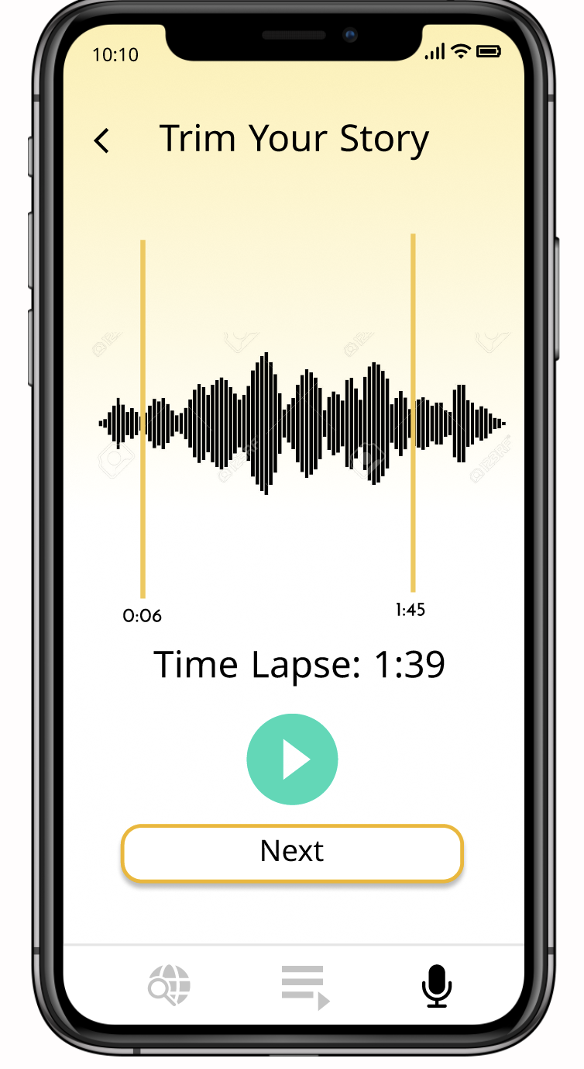
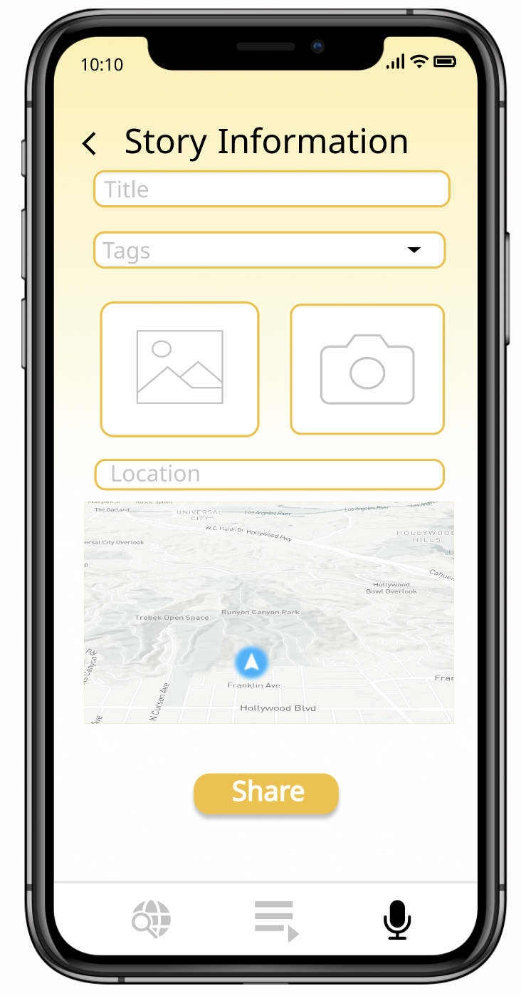
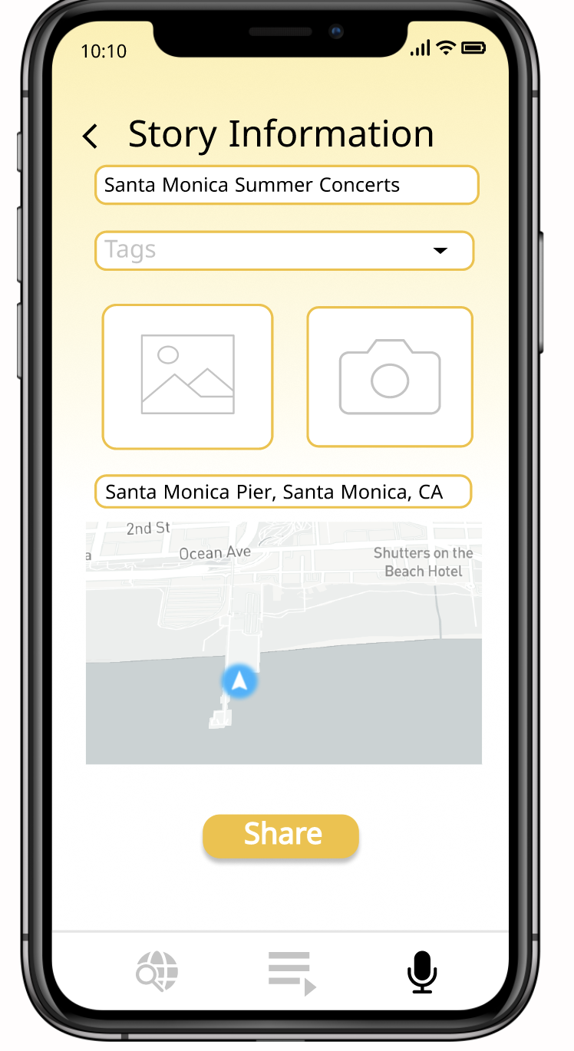
TASK FLOW: Record Your Own Story
Notes:
Method 2: Listening to remote stories. You can search for locations using the search bar. Then you can either listen to the story by pressing the mint button or using the preview page as pictured on slide 23.

Slide 30
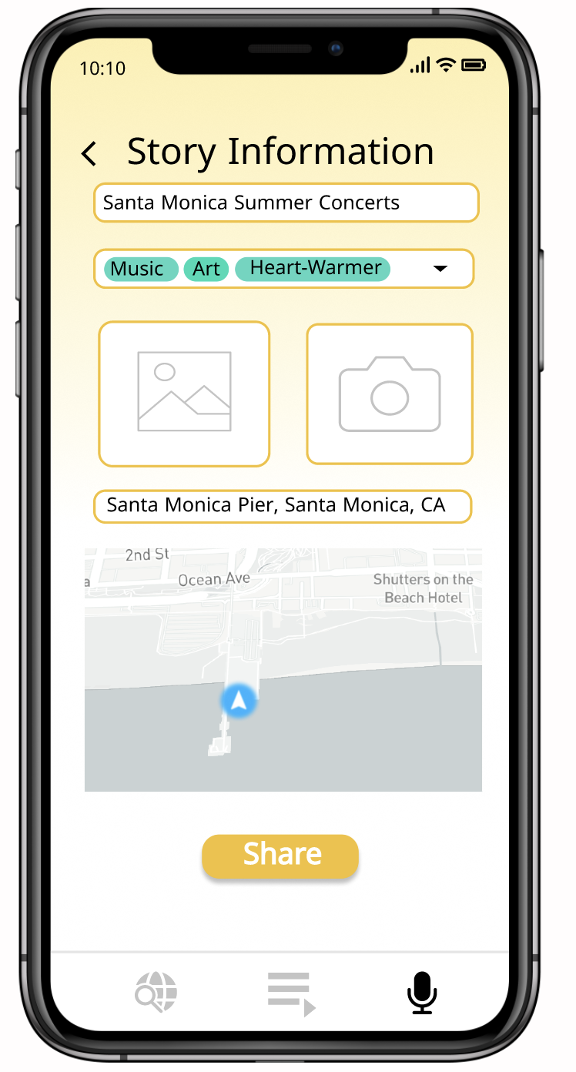
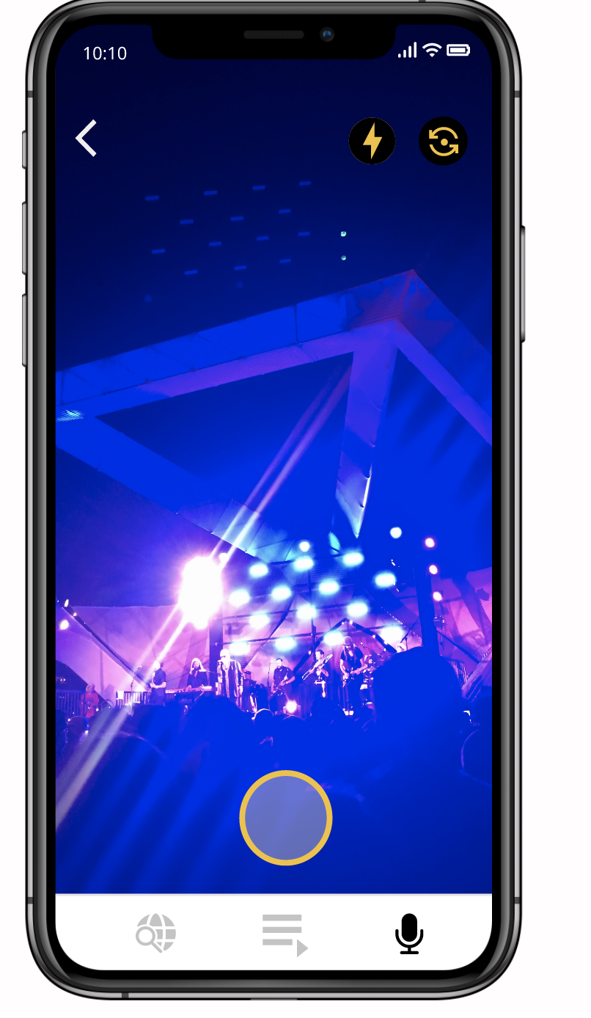
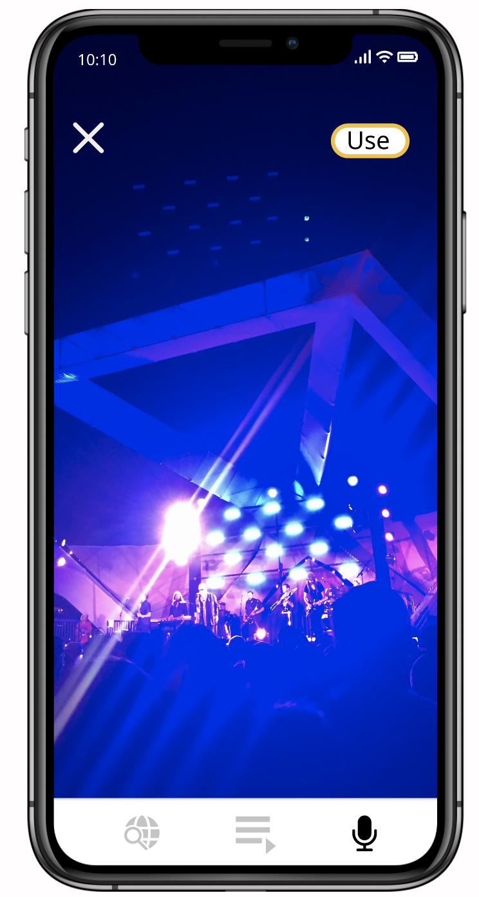
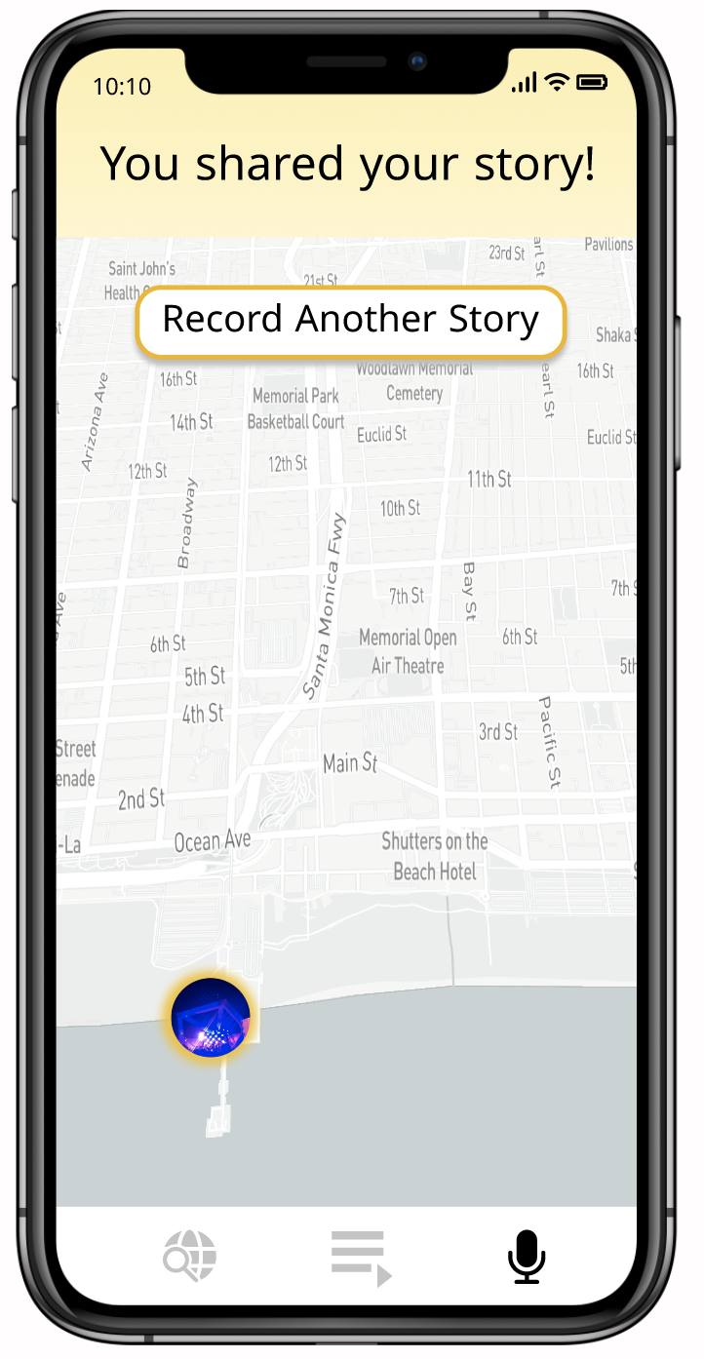
TASK FLOW: Record Your Own Story

Slide 31
DESIGN AND PROTOTYPING TOOLS
◼ Used Canva for icons and images
◼ Figma for UX prototype development
THE GOOD
Easy collaboration
Reusable components
Integrated Plug-ins for map interface and icons
THE BAD
Interactions and connections copied over when copying parts of pages
Steep learning curve
Annoying to make minor changes to components

Slide 32
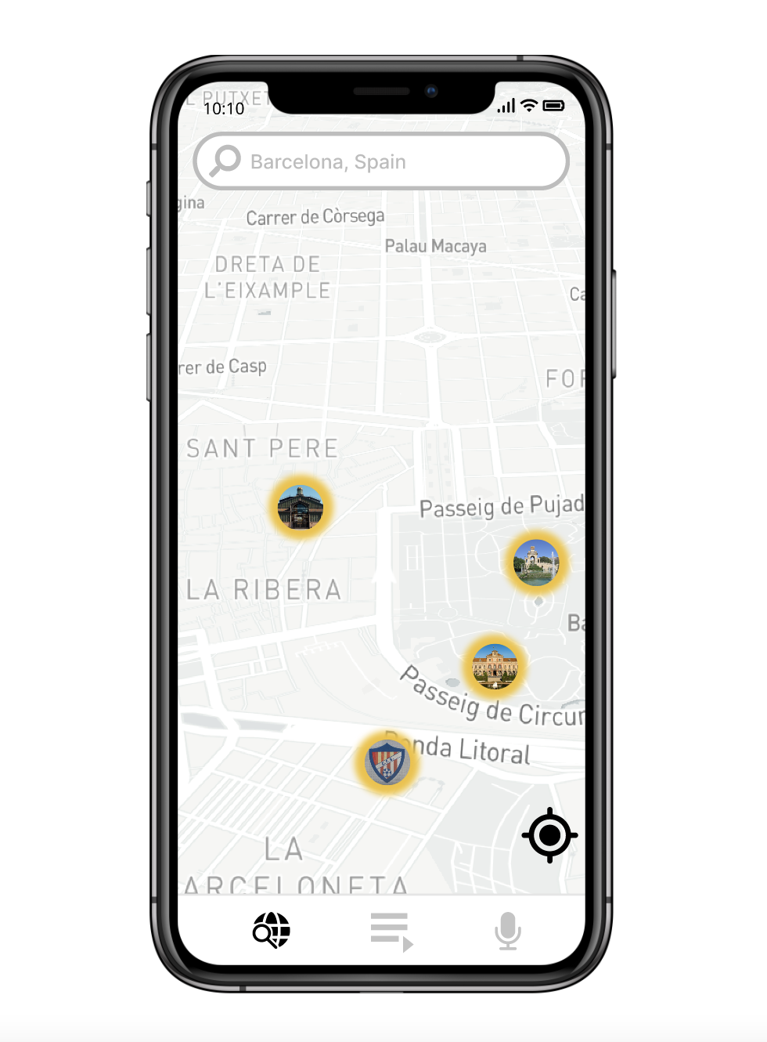
LIMITATIONS
Couldn’t implement a completely functional search bar; user can only navigate to Barcelona
Couldn’t implement listening functionality for all stories in list
Editing story limited to just tapping on trimming bars

Slide 33
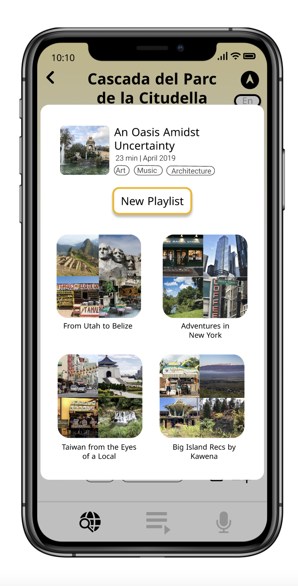
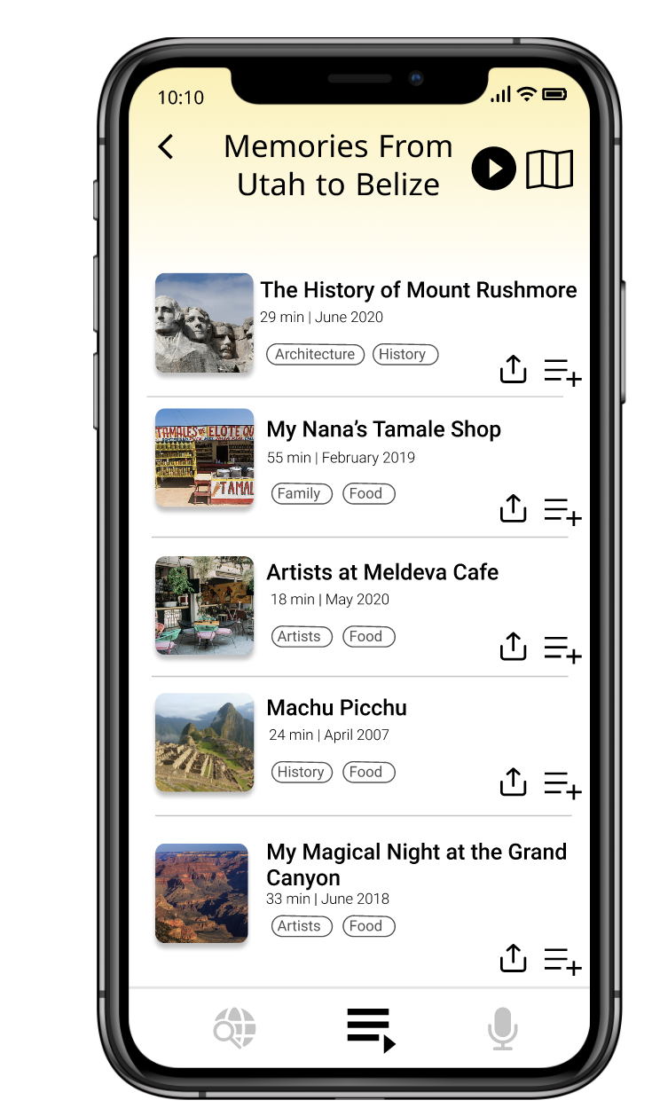
LIMITATIONS
Adding to playlist not reflected in playlist because it is unclear which story the user will try to add
Limited scrolling for map view (such as on home screen or for viewing a playlist as a map)
No animations

Slide 34
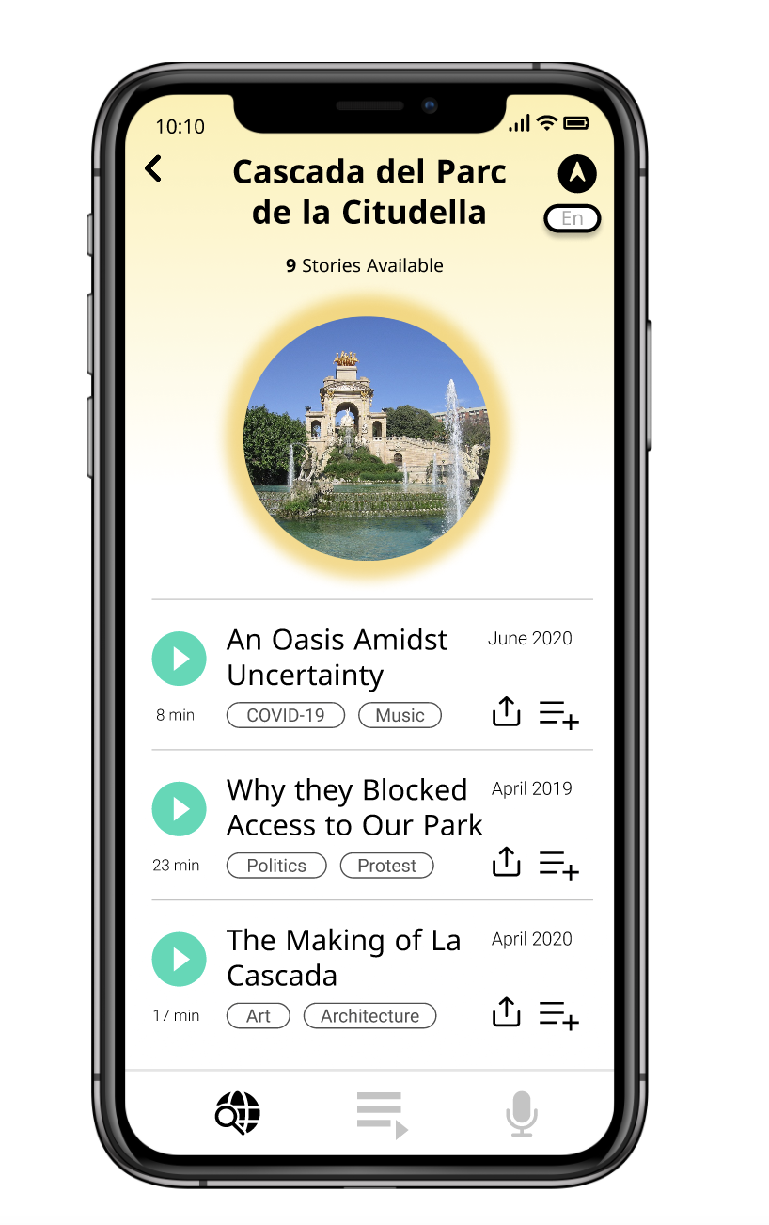
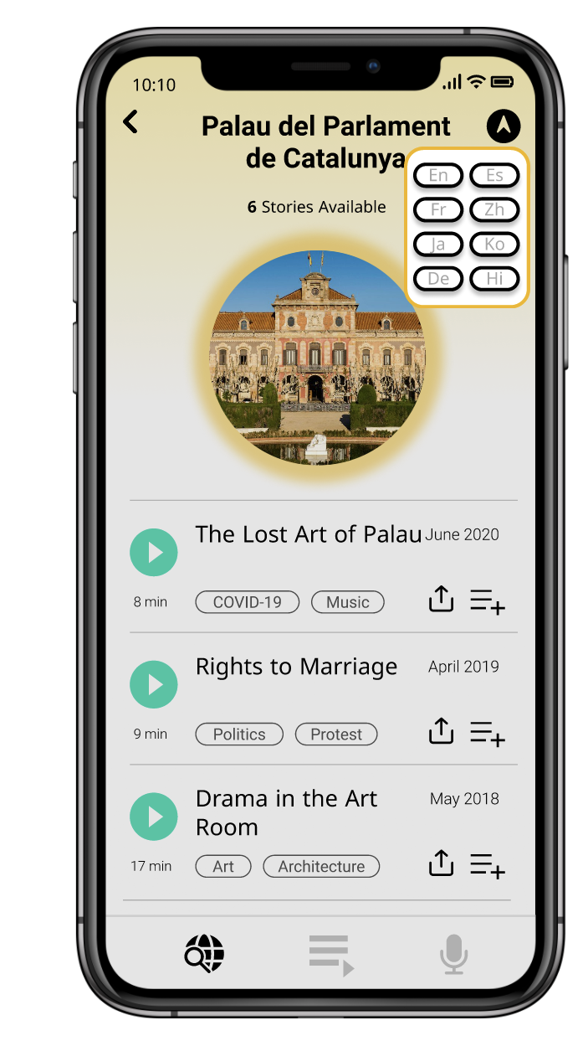
TRADEOFFS
The functionality for sharing a story isn’t connected to the rest of the phone interface (such as messages, WhatsApp, etc)
Stories only available in Spanish and English currently
No implementation of the actual audio of the stories

Slide 35
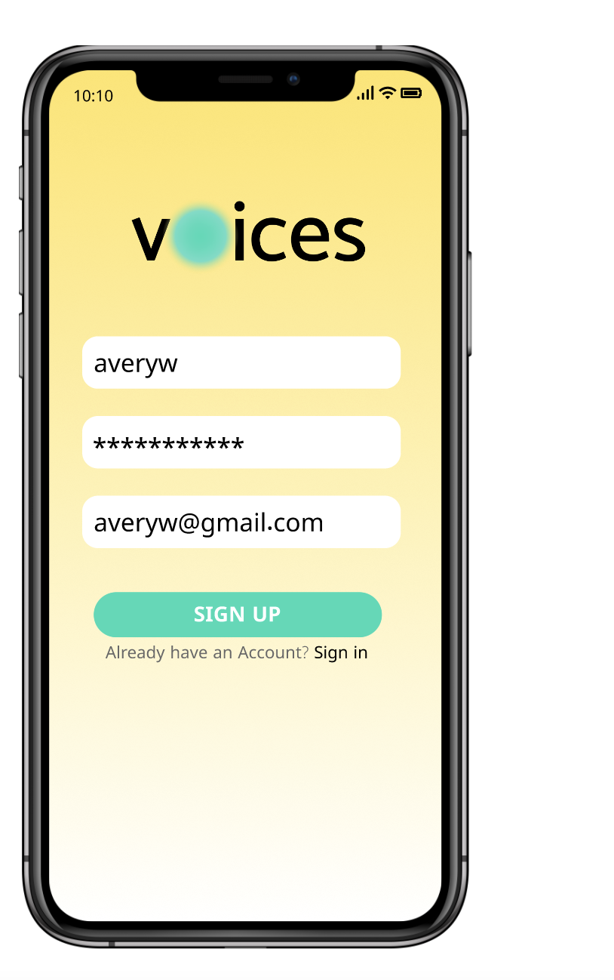
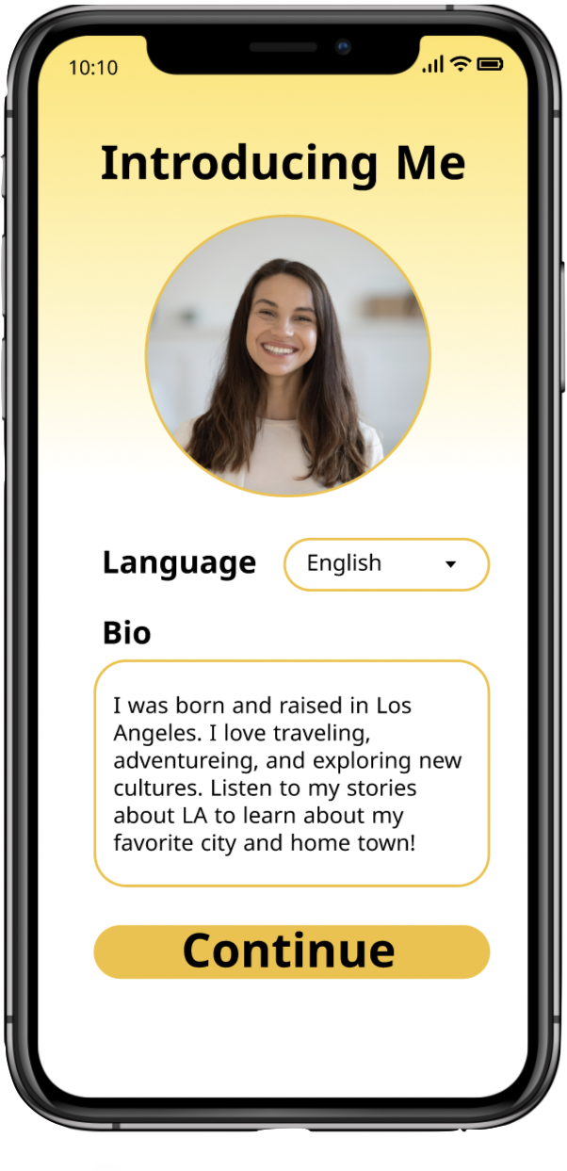
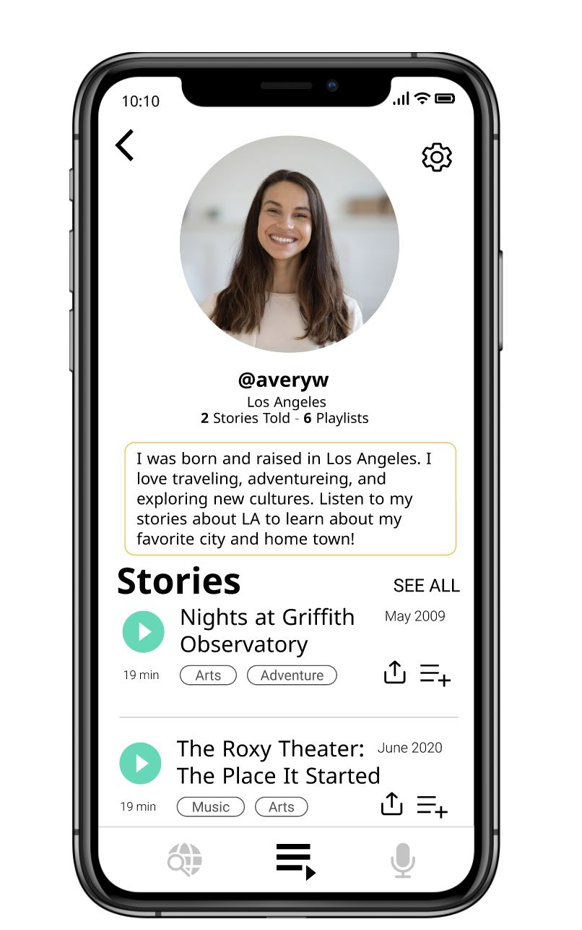
WIZARD OF OZ TECHNIQUES
Onboarding
All search bar text are presets
Tags are preselected
Onboarding process is preset
For our example of Avery, there is a “time jump” from her starting out as a new user to her being a returning user that has playlists and stories already posted in their profile
Navigation screen automatically finishes after set time
Complete Profile

Slide 36
ADDITIONAL PHOTOS

Slide 37
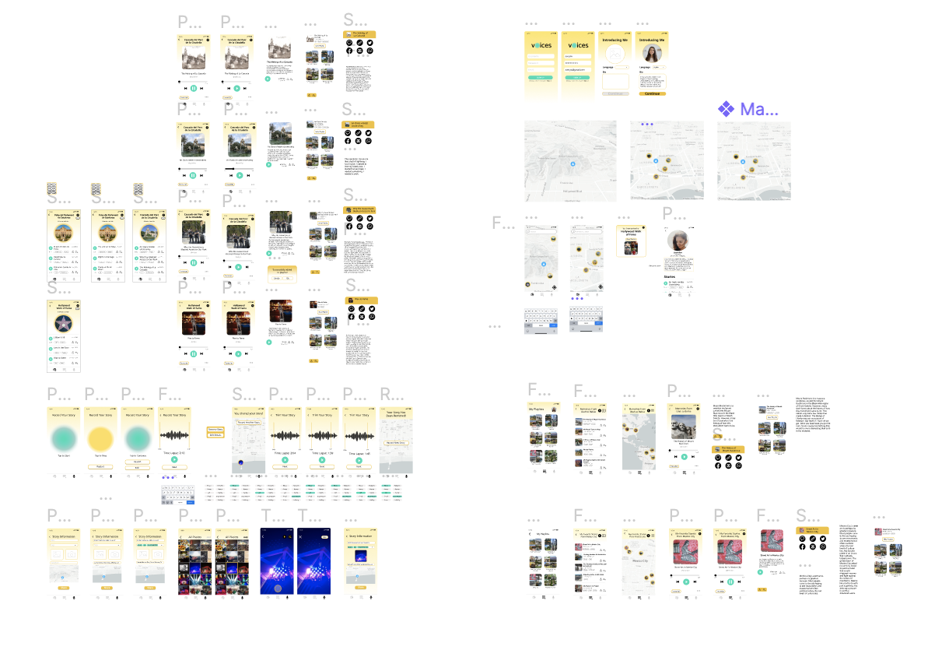
FULL PROTOTYPE

Slide 38
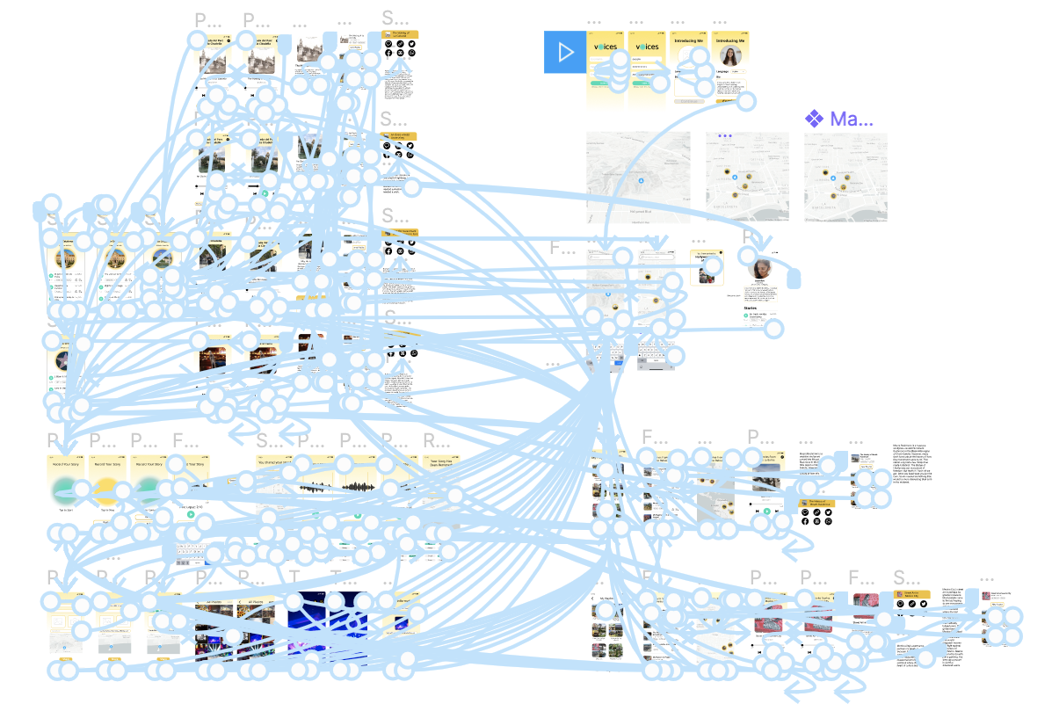
FULL PROTOTYPE (ANIMATED)

